Slide 1
Fairness in Machine Learning for Healthcare #FairMLHealth
Muhammad Aurangzeb Ahmad* ^{1,2}, Carly Eckert MD MPH^{1,3}, Christine Allen¹, JuHua Hu², Vikas Kumar¹, Arpit Patel MD⁴, Ankur Teredesai^{1,2}
1) KenSci Inc. 2. Department of Computer Science and Systems, University of Washington Tacoma
* corresponding author: maahmad@uw.edu

Slide 2
#FairMLHealth Tutorial Overview
Foundations: Fairness in Healthcare ML
Measurement & Mismeasurement of Fairness
Operationalizing Fairness in Healthcare ML
Best Practices
Library Demo
Conclusion

Slide 3
Foundations: Fairness in Healthcare ML

Slide 4
Elements of Ethical ML in Healthcare
Explainable & Transparent
Fair &
Unbiased
Robust
Privacy & Security

Slide 5
Bias & Discrimination in Healthcare: History
The seminal figures of modern medicine (Anton van Leeuwenhoek⁽¹⁶³²⁻¹⁷²³⁾, the Father of Microscopy, Marcello Malphighi⁽¹⁶²⁸⁻¹⁶⁹⁴⁾, the Father of Histology, Carl Linnaeus⁽¹⁷⁰⁷⁻¹⁷⁷⁸⁾ the Father of Biological Classification) held racial and biased beliefs that greatly influenced modern medicine and healthcare (Byrd et al 2001).
Education: Many Western physicians assumed poor health as normal for Black populations ("Negro Diseases”). This was part of medical schools' syllabi until the 1960s in the US (Savitt 2002).
Medical Profession: With few exceptions Blacks were not represented in the medical profession in the US until the late 19th century and the percentage in the profession remained at 2% from 1900 to 1980.
Sterilization: A third of Puerto Rican women of childbearing age were sterilized under coercion from 1930s to 1970s. Many Mexican and Native American women were also sterilized (de Malave 1999). International examples of sterilization pf indigenous people are abundant e.g., India in mid70s (Wilson 2017).
Fatality: Higher prevalence of death during childbirth and lower birth weight babies among pregnant Black women (Randall 1995).
Notes:
There are racial and biased statements against Black people in pretty much all ancient medical literature be it Greek, Indian, Arab, Chinese
The roots of modern bias and discrimination go all the way back to the birth of modern science
Representation of Blacks in the medical profession was non-existent in the West which made perpetuation of bias easier/worse

Slide 6
Bias & Discrimination in Healthcare: History
Tuskegee Experiments: From 1932 to 1972, the US government tracked and deceived 600 hundred low-income Black men in Tuskegee, AL for a study where sham treatments were given for Syphilis. Many men needlessly passed the disease to their family, suffered and died (Thomas and Quinn 1991).
Sickle Cell Disease: which mostly affects Black populations, received less attention in research than other prominent diseases, mainly because its disproportionately affects people of color (Wailoo 2017).
Cardiac Bypass Surgery: Physicians refer significantly less Black men for cardiac bypass surgery than white men. This is due to the incorrect perception that Black patients were less well-educated and less likely to engage in physical activity after the surgery. Thus, the physicians concluded that they were poorer candidates for the surgery (Malat and Griffin 2006).
Bias in Non-Human Healthcare Research: A 2011 literature survey of 10 different fields within Biology revealed that single-sex studies of male animals outnumbered those of females 5.5 to 1. Since the 1960s male bias in non-human studies had increased (Beery and Zucker 2011).
Notes:
Healthcare is rife with inequality and racial prejudice. Three examples of this are presented here. The Tuskegee study is deplorable, Sickle cell was understudies for a long time and human bias led to discriminatory selection for candidates for bypass surgery. These are but a few examples of issues ML and AI will have to broadly address when we think of fairness in healthcare ML. The main point I am driving towards as you can tell by now is that designing techniques that address the issues in data are not going to be enough to design Fair and Trustworthy AI systems for healthcare.

Slide 7
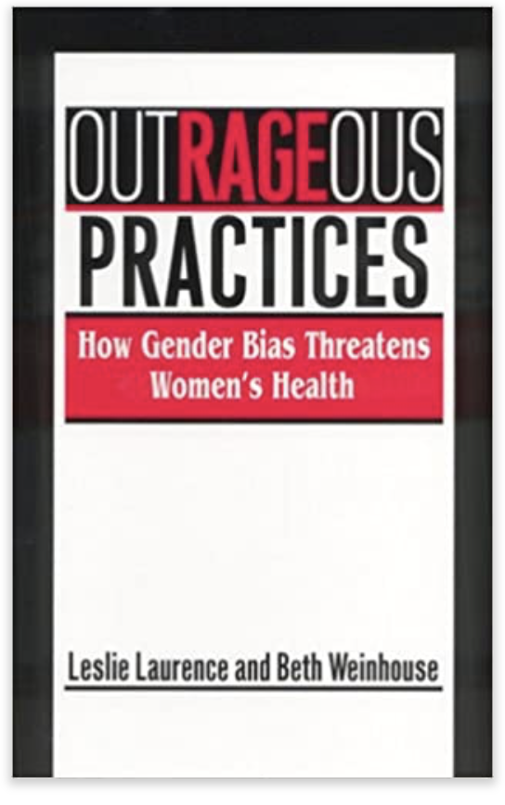
Bias & Discrimination in Healthcare: History
Rockefeller University’s NIH-supported study the role of obesity in breast and uterine cancer did not enroll women (Simkin 1995)
Yet the study concluded that older women were less likely to be given lifesaving interventions as compared to men (Bierman 2007)
Other studies observe that women are less likely to be given analgesia than men (Chen 2008)
The 1982 Multiple Risk Factor Intervention Trial explored the impact of dietary and exercise in preventing heart disease included no women out of trial size of 13,000
Notes:
And its obviously not just race. Gender discrimination has also played a major role in delivery of healthcare. According to a 2009 analysis US women make up just 37% of research subjects even though they comprise of more than half of the US population.

Slide 8
Bias & Discrimination in Healthcare: History
For most of the 15 leading causes of death in the US including heart disease, cancer, stroke, diabetes, kidney disease, hypertension, liver cirrhosis and homicide, Blacks have higher death rates than whites (Kung et al. 2008).
These elevated death rates exist across the life-course with Blacks and American Indians having higher age-specific mortality rates than whites from birth through the retirement years (Williams 2005).
Experiencing racist treatment affects health. Experience of interpersonal racism has been observed as a mechanism that partially explains differences between Aboriginal and non‐Aboriginal peoples' health (Larson et al 2007).
There is a long history of unfair diagnoses of psychological conditions in minorities and women (Gard et al 1997).

Slide 9
Bias in Healthcare AI: History
One of the earliest examples (1970s) of algorithmic discrimination comes an algorithm used by St. George’s Hospital Medical School in the UK. It was discriminating admittance decisions based on race and gender.
In 1976 Joseph Weizenbaum raised the question of algorithmic bias, one of the first computer scientists to do so (Weizenbaum 1976).
Clinicians are more likely to believe AI that supports current practices and thus perpetuate implicit biases (Parikh 2019).
Among women with breast cancer, Black women have a lower likelihood of being tested for high-risk mutations. An AI model that uses genetic tests as a predictor is more likely to mischaracterize the risk of breast cancer across groups defined by race (Parikh 2019).
Notes:
To stress the point home, medicine is not alone in this. Computer Science has also played a role. Algorithmic discrimination goes all the way back to the 1970s.
The literature of fairness and bias in ML started to appear in the late 1990s – early 2000s.
It was not until the 2010s that it became a prominent subjection in the AI/ML community and recent articles are starting to shine the light on the issue. The role of this community will go a long way in shaping the solutions.

Slide 10
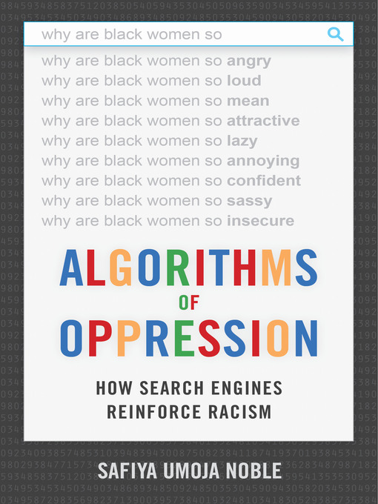
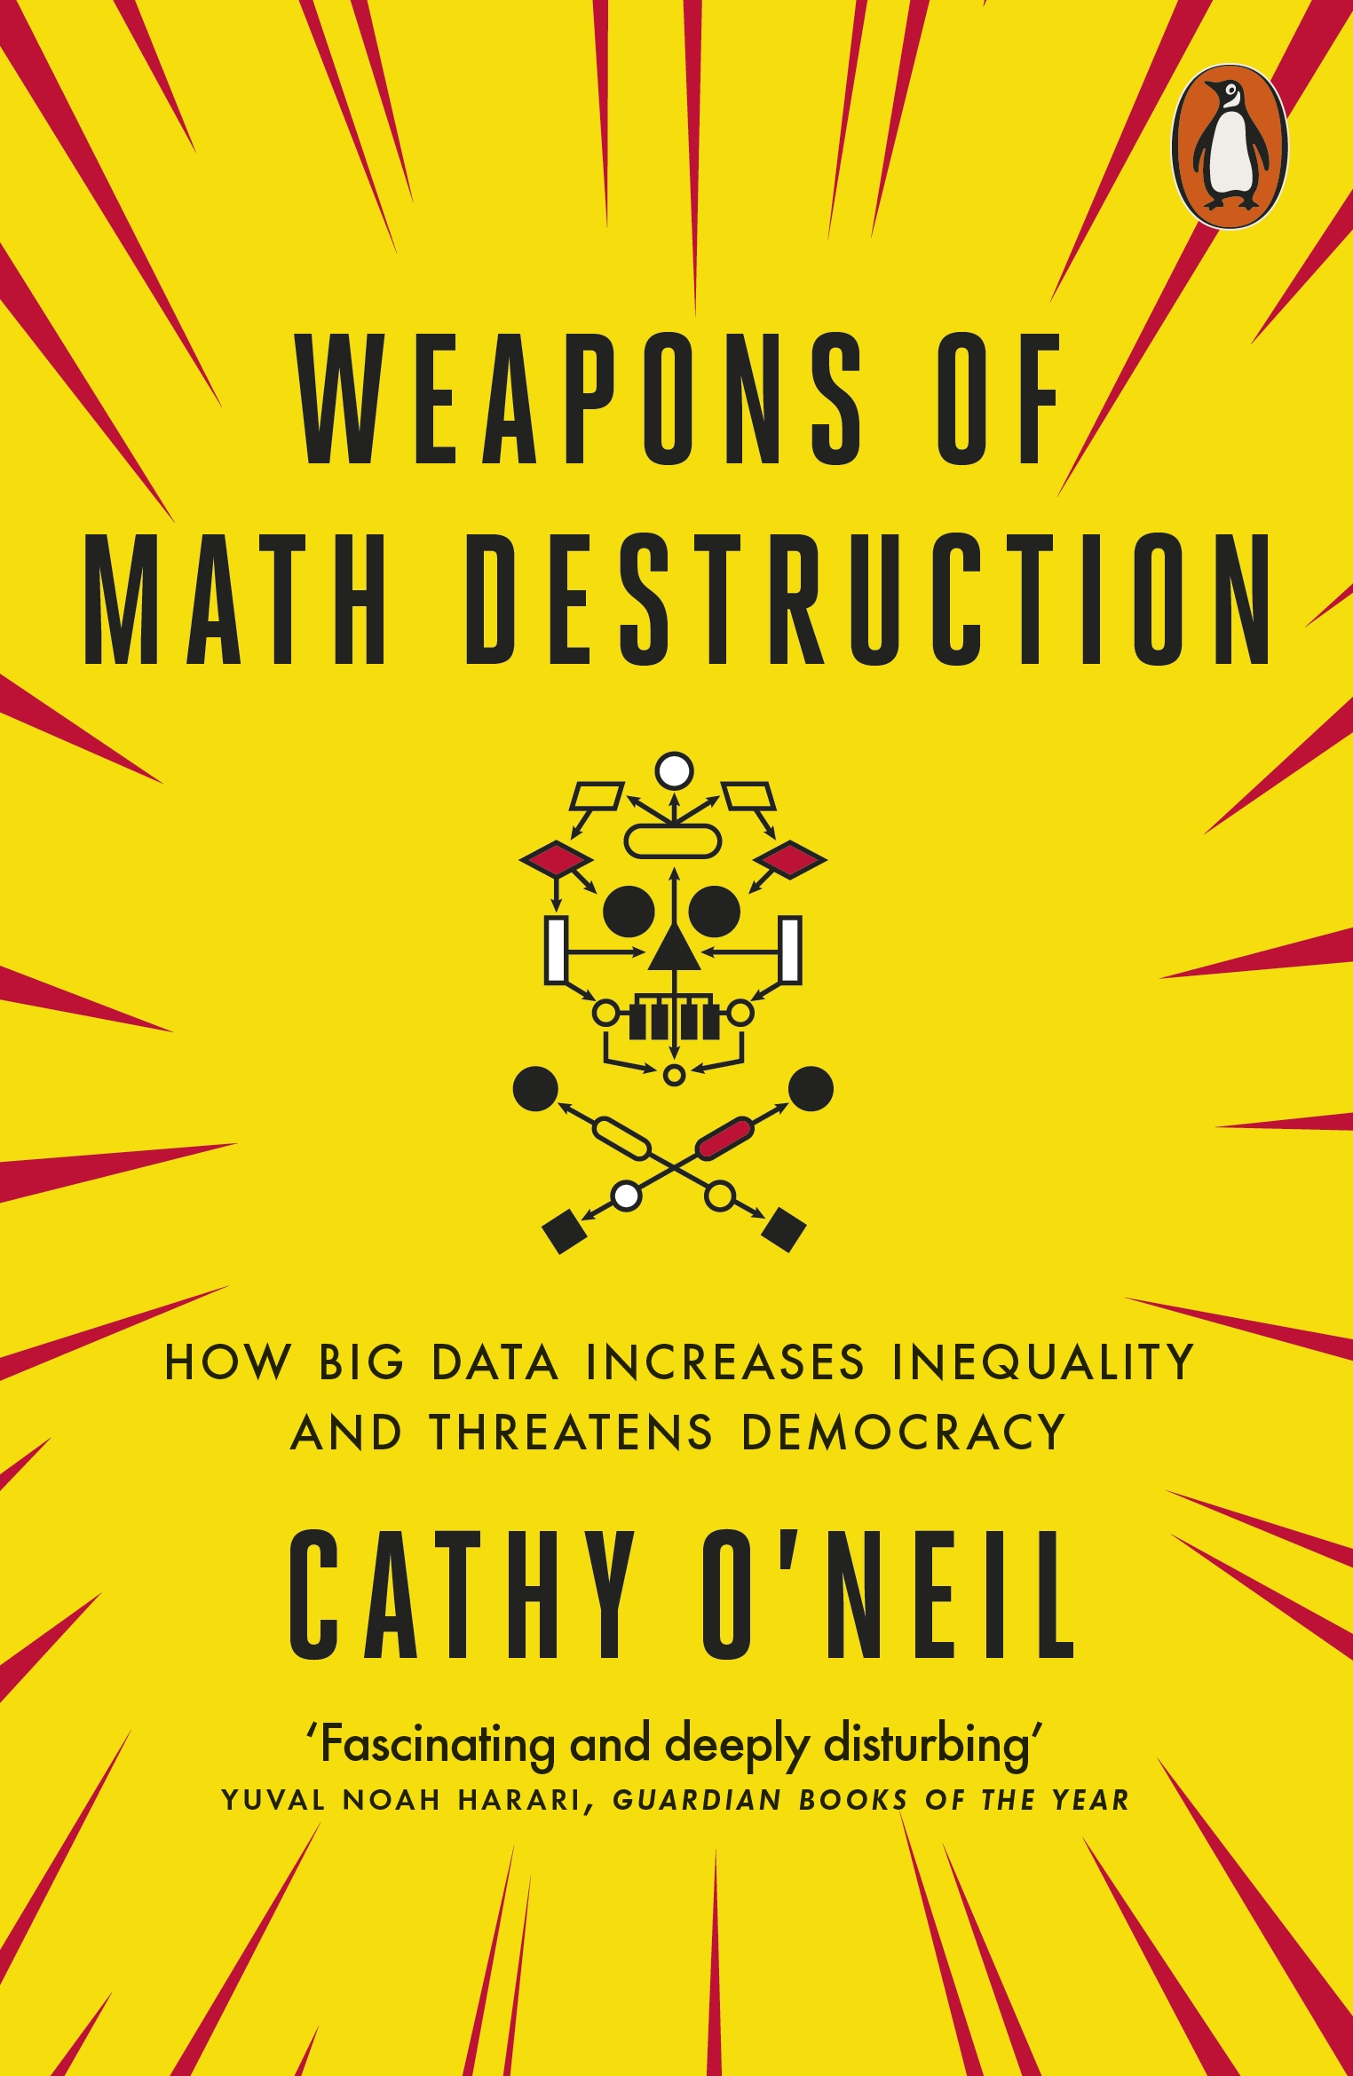
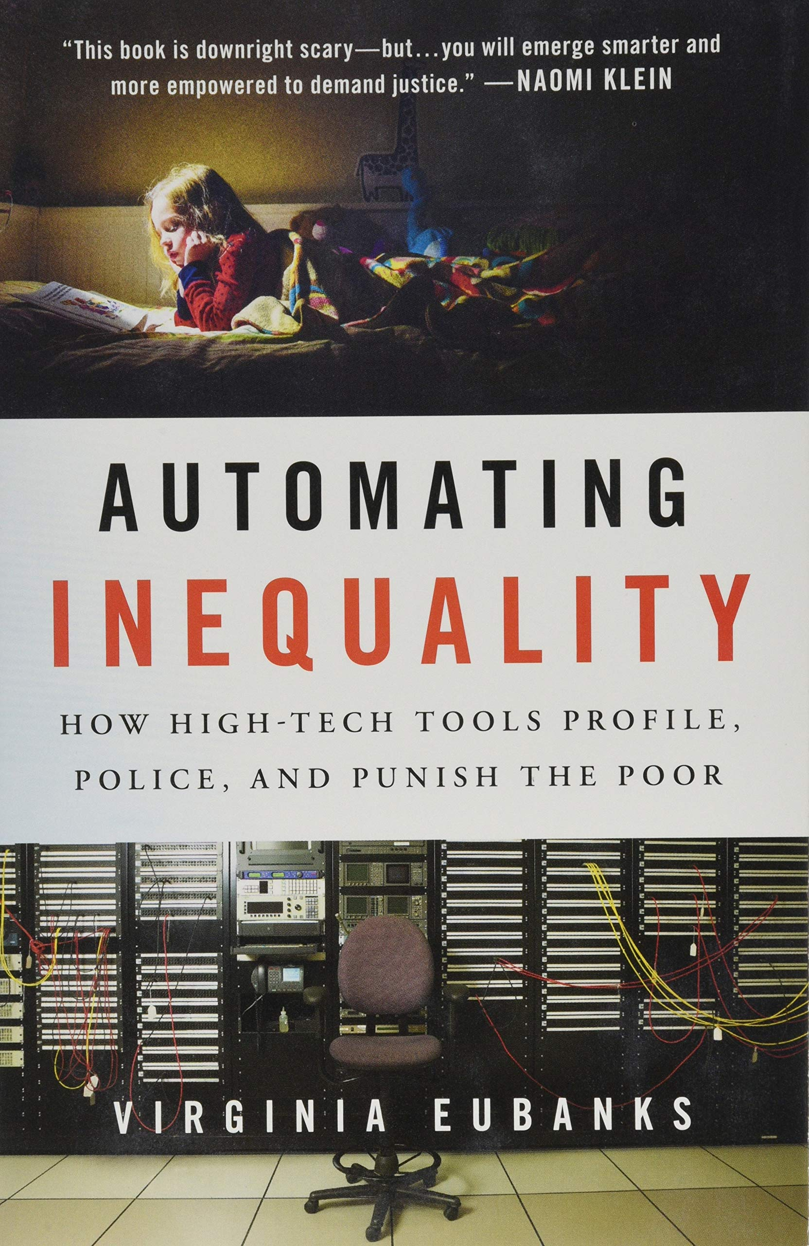
Bias in Healthcare AI: History
Idahoans with cognitive or learning disabilities had their healthcare benefits reduced by $20,000—30,000 based on an AI algorithm without any explanation. This led to a lawsuit by ACLU that revealed the underlying algorithm (Stanley 2017).
Notes:
Stanley, Jay. "Pitfalls of artificial intelligence decision making highlighted in Idaho ACLU case." Privacy & Technology (2017).

Slide 11
Making AI Fair in an Unfair World?
Humans are biased and discrimination is a universal phenomenon
People have implicit and explicit biases which permeate socio-technical systems
Data points in healthcare represent human lives that may be affected by algorithmic decisions
Thoughtful development and implementation of AI and models is required before AI in healthcare becomes pervasive

Slide 12
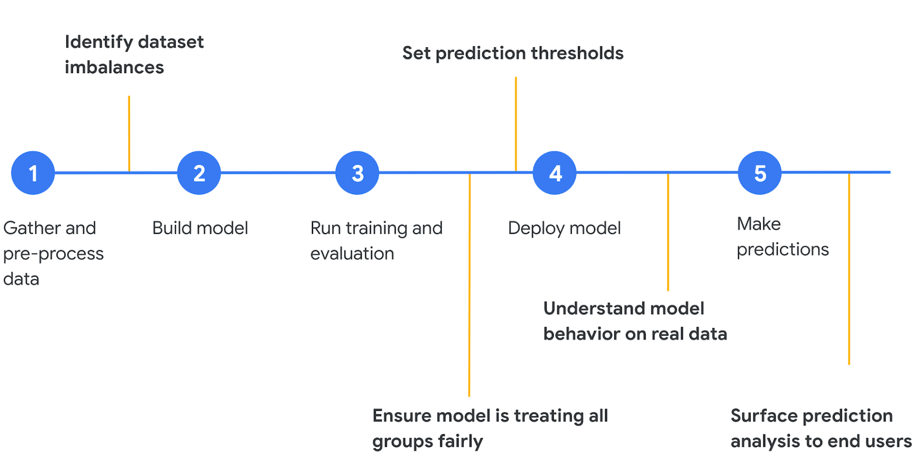
Fairness in Machine Learning is more than imbalanced datasets!
[Google Cloud 2018]
Notes:
My Main message: Its just not the dataset that impacts fairness but rather every element in the machine learning pipelines effects fairness e.g., pre-processing, algorithms, usage etc.

Slide 13
Bias in Healthcare AI: Is it just a data problem?
Generalizability and representativeness are also important considerations in healthcare. The generalizability of AI algorithms across subgroups is critically dependent on factors like representativeness of included populations, missing data, and outliers.
EHRs are observational databases, the data reflects not just the health of the patients but also their interactions with the healthcare system e.g., the date of a code for diabetes is when the physician made the diagnosis, not when the patient first developed the disease (Agniel 2018).
The billing code used for an office visit may be influenced by reimbursement policies in addition to the original reason for the visit.
Practices regarding data capture may change over time e.g., reporting patient falls, opioid prescribing increased from 2005-12, but at rates that differed by practice and patient population (McLintock 2019).
Data as a signal. Lab tests are ordered more often for sick patients (Agniel 2018).

Slide 14
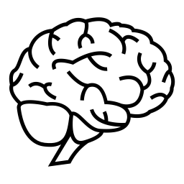
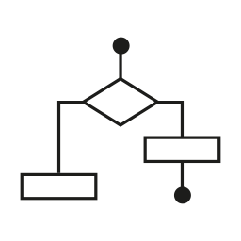
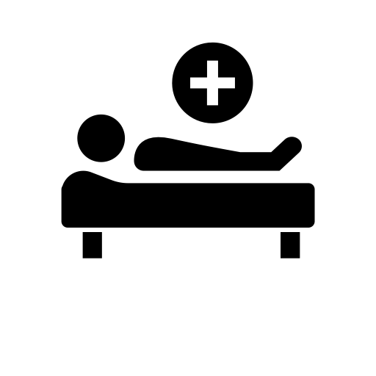
Fairness in ML as a Systems Problem
ML Solution
User
Domain Knowledge
Data
Algorithm
Model
Intervention
Each constituent element can contribute towards making the solution unfair or biased
Use Case
Context

Slide 15
Legal Protected Classes in the US
Race (Civil Rights Act of 1964)
Color (Civil Rights Act of 1964)
Sex (Equal Pay Act of 1963; Civil Rights Act of 1964)
Religion (Civil Rights Act of 1964)
National origin (Civil Rights Act of 1964)
Citizenship status (Immigration Reform and Control Act 1965)
Age (Age Discrimination in Employment Act of 1967)
Familial status (Civil Rights Act of 1968)
Disability status (Rehabilitation Act of 1973; Americans with Disabilities Act of 1990)
Pregnancy (Pregnancy Discrimination Act 1978)
Veteran status (Vietnam Era Veterans' Readjustment Assistance Act of 1974; Uniformed Services Employment and Reemployment Rights Act of 1994)
Genetic information (Genetic Information Nondiscrimination Act of 2008)
[Barocas and Hardt 2017]

Slide 16
Legal Protected Classes Globally
Additional protected classes in other countries
Nigeria: Constitution prohibits discrimination on grounds of political affinity and ethnic or tribal group
Portugal: Ancestry, gender reassignment, economic status, education, social origin or status, genetic heritage, reduced working capacity, chronic disease, nationality, territory origin, ideological beliefs, union membership and maternity
Uganda: HIV Status
Vietnam: discrimination against outsourced employees is prohibited
Israel: participation in military service (including military reserve duty)
India: Scheduled castes and OBCs (Other Backward Classes) people is prohibited
Pakistan: Discrimination against transgender people is prohibited

Slide 17
Fairness in the Age of COVID-19
Healthcare rationing: Due to stresses caused by the COVID-19 pandemic on national healthcare systems globally
When limited resources in acute medical settings cannot be accessed by all patients who need them
Scenarios
ICU: What happens when ICU demand exceeds the critical care facilities available? How should doctors decide between which patients to treat?
COVID-19: Real world scenarios with COVID-19, insufficient knowledge about efficacy with insufficient supply of medications [White 2020]
Randomized Centralized Lottery Allocation: Solves the problem of (i) Unfair Allocation (ii) Learn new knowledge about the underlying condition
Vaccine allocation and historically marginalized populations

Slide 18
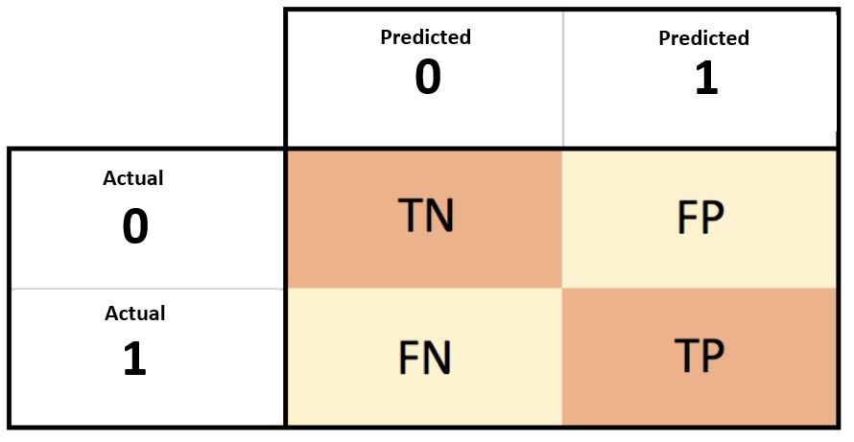
Fairness is Stakeholder Dependent
Physician: Of the patients that are labeled high risk of dying from COVID-19, how many are likely to be high risk?
Patient: What is the probability that I will be incorrectly labeled as low risk? Given that I am from a protected class, will I be given the same clinical services according to the best evidence
Societal (Group Fairness): Are the risks balanced across all protected classes?
[Narayanan 2018]

Slide 19
Dimensions of Fairness in Healthcare AI
Computational
Data Bias
Model Bias
Loss Function Bias
Post-Hoc optimization
Social/Institutional
Structural Bias
Cultural Practices
Embedded Practices
Cognitive
Automation Bias
Automation Complacency
Delivery Bias
Bias in Computer Systems
Technical Bias
Pre-existing Bias
Emergent Bias
[Friedman & Nissenbaum, 1996]

Slide 20
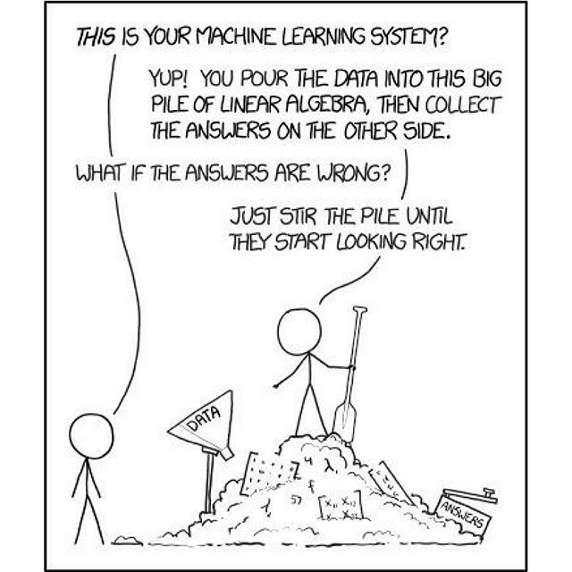
Weapons of Math Distraction ~ Cathy O'Neil
Dangers of making fairness problems as only technical problems to solve [Moritz Hardt]
“Technical work without understanding social context”
“Thinking we’re more rigorous than social scientists”
“Justifying an approach by the math it entails”
“Big Data processes codify the past. They do not invent the future.” [O'Neil 2016]

Slide 21
Sources of Bias in Healthcare AI
Data Bias
Non-Data Biases
Model Bias
Loss Function Bias
Post-Hoc optimization
Bias in Delivery
Cognitive Biases
Social Biases
Bias in the ML Cycle
Selection/sample bias
Response bias
Publication bias
Prejudicial bias
Measurement bias
Hawthorne effect
Social desirability bias
Self-reporting bias
Algorithmic Bias
Loss Function Bias
Post-Hoc Optimization
Outcome Fairness
Lack of Understanding
Explainability
Lack of understanding/ Assume model is fair
Don't care
Sources of Bias
Equal representation
Bias mitigation Algorithms
Fairness metrics
Explainable AI
Acknowledgement & Explanation of bias during model delivery
Bias Mitigation
Notes:
Selection/sample bias - selection of individuals, groups or data for analysis in such a way that proper randomization is not achieved, thereby ensuring that the sample obtained is not representative of the population intended to be analyzed
Response bias - tendency for participants to respond to tests or assessment items based on some factor other than the content; also, there is a consistent difference between those who agree to provide responses and those who refuse
Publication bias - there is a greater likelihood that studies with positive results will be published
Prejudicial/Latent bias - training data content is influenced by stereotypes or prejudice within the population
Measurement bias - a systematic measurement error (e.g. offset baseline) that skews all data
Hawthorne effect - the alteration of behavior by the subjects of a study due to their awareness of being observed
Social desirability bias – desire for participants to respond to potentially private or sensitive topics in a manner that seeks approval, especially in cases where anonymity and confidentiality cannot be guaranteed
Self-reporting bias - measurement inaccuracy that originates with the respondent due to varying baseline, desire to hide the truth, or some other influence (see response bias and social desirability bias)
Recall bias - participants can erroneously provide responses that depend on his/her ability to recall past event
Algorithmic bias - systematic and repeatable errors that create unfair outcomes
Preexisting - codification of already-present biases
Technical - occurs due to the technical limitations of actually presenting the data (e.g., names at the top of a list will get preference, even if scored equally to those lower down)
Emergent - development of new biases or new understandings of biases as technology develops (e.g., growing popularity of audiobooks in favor of print disadvantages the deaf population)

Slide 22
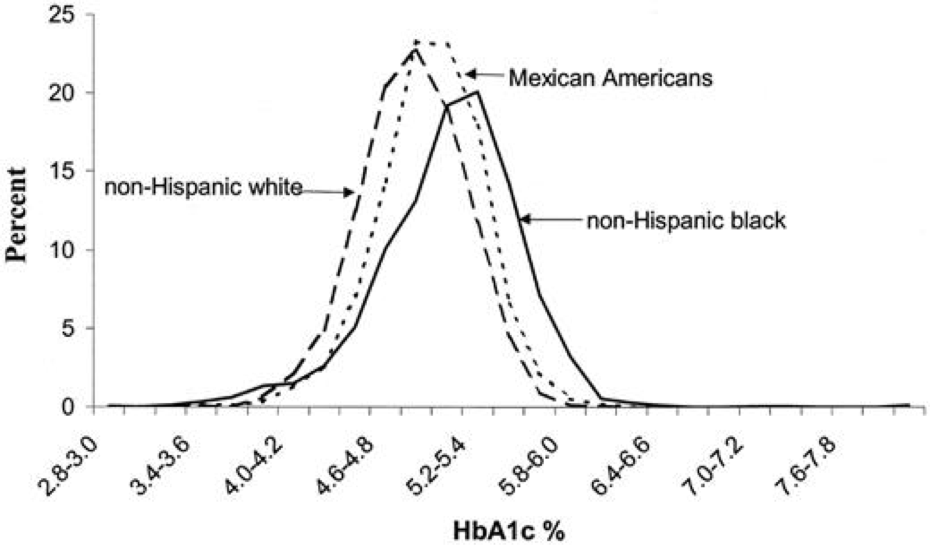
AI needs FAT
HbA1c distribution by ethnicity in U.S. children and young adults ages 5–24 yr (NHANES-3, 1988–1994) [Saaddine et al., 2002]
Hemoglobin A1c (HbA1c): widely used as a measure of risk for the development of diabetic complications [Herman et al., 2012, Edelman et al., 2004, McCarter et al.. 2004]
Notes:
The third issue and final issue that we as data scientists are struggling with today is building models that stand the test of “Fairness”. Lets look at some examples. The data in this plot tells us that children and young adults with different ethnicities are bound to have different distributions of HbA1c values just within the US. Any model that ignores this variation will optimize for the ethnicity that is most prevalent in the underlying dataset on which it was trained. Not just ethnicity but age, gender and even social determinants can often lead to significant variation and AI that is not tuned to estimate and eliminate such bias will produce biased models.

Slide 23
Measurement & Mismeasurement of Fairness

Slide 24
How we are categorized through data affects how we will be treated
- Frank Pasquale in The Black Box Society

Slide 25
Discrimination: Treatment vs. Impact
Discrimination: The unjust or prejudicial treatment of different categories of people or things, especially on the grounds of race, age, or sex
(Oxford Dictionary)
Disparate Treatment: The treatment depends on class membership
Example: implicit bias leading to differences in treatment in acute coronary syndrome
Disparate Impact: The treatment appears to be neutral, but it impacts the protected class
Example: hospital relocation and access to care for minority classes
[Barocas, S. and Selbst 2016]

Slide 26
Tensions between disparate treatment and disparate impact
Different groups may need to be treated differently to maintain fairness
Humans (clinicians) deal with it on case-by-case basis. But this is not scalable for algorithmic decision making [Narayanan 2018]
There is an element of subjectivity across clinicians while making such assessments
Example: Patient "no show" prediction
N Days
Patient History
Appointment Date

Slide 27
Example: Differential Treatment by Race
James, a 65-year-old Black male and David, a 65-year-old white male, both have coronary artery disease. They experience chest pain and shortness of breath and are rushed to the ED by their spouses.
Both are seen by the same ED physician and are both diagnosed as having an acute myocardial infarction (a heart attack)*. Yet the clinical recommendations and interventions offered are different and James is treated less aggressively
How do we determine if the two patients are treated fairly? [Arora et a. 2018]
For the purpose of this illustration, we are considering that all clinical factors are the same between these two patients.

Slide 28
Protected Classes & Proxy Variables
Many variables of interest correlate with protected class.
Not all are considered illegitimate to use in decision making. [ e.g., educational qualifications in hiring decisions. ]
Many researchers have proposed methods to identify and mitigate “proxy discrimination”.
Protected Classes & Potential Surrogates
Age
Sex
Race / ethnicity
Insurance status
Disability, functional status
Zip code / census tract
Costs of care / utilization
Marital status
Disease conditions: HIV, mental health
Genetic results: BRCA

Slide 29
Model Performance and Fairness
Differences in performance
Limited features
Skewed distributions
Limited data availability
Distribution of Error across sub-populations
Different models with the same reported accuracy can have a very different distribution of error across population
Understanding disparities in predicted outcome
Skewed Proxies
External processes not captured in data

Slide 30
Fairness & Performance
Fairness Measurement What are the different ways to measure Fairness
Predictive Performance How well is the model performing
Calibration How good is the model calibration
Intervention & Allocation How are the insights from the model being used to intervene

Slide 31
Algorithm & Composition Bias
Algorithmic Bias
Downstream consequences of model choice or hyperparameter choice
Algorithm assumptions may lead to biased models e.g., Naïve Bayes
Composition/Team Bias
Knowledge gaps in team
Consultation with stakeholders and domain experts
Representation of people affected

Slide 32
Fairness through Unawareness
A predictor achieves fairness through unawareness if protected attributes are not explicitly used in the model
There may still be many variables in the data that are proxies for protected variables e.g., sex, age etc.
Inclusion of protected variables may be necessary to avoid discrimination
Discrimination may be needed in order not to discriminate
"There is no such thing as fairness through unawareness." - Moritz Hardt
Notes:
https://towardsdatascience.com/a-tutorial-on-fairness-in-machine-learning-3ff8ba1040cb

Slide 33
Demographic Parity
Foundation
Proportion of each protected class should receive the positive outcome at equal rates
Inspired from the four-fifths rule
Used to audit models for Disparate impact
When to use Demographic Parity
Change the state of our current world to improve it
Remedy historical biases that may have affected the quality of our data
Prevent the reinforcement of historical biases
Notation
X ∈ Rᵈ | Non-protected Features
A ∈ {0, 1} | A (binary) protected attribute
C | Binary classifier: c(X,A) ∈ {0,1}
Y ∈ {0, 1} | Target Variable
(X, A, Y) ~ D | Underlying distribution D
P₀ [c] | P [c | A= 0]
Formulation
P₀ [C = c] = P₁ [C = c] ∀ c ∈ {0,1}
Alternate Nomenclature
Independence, Statistical Parity

Slide 34
Equalized Odds
Formulation
C is independent of A conditional on Y:
Since the definition is restrictive the following relaxed version is often used
P₀ [C = 1| Y = 1] = P₁ [C = 1| Y = 1] which is called Equality of Opportunity
When to use Equalized Odds
When ensuring that accuracy is equally high in all demographics even punishing models that perform well only on the majority
Notation
X ∈ Rᵈ | Non-protected Features
A ∈ {0, 1} | A (binary) protected attribute
C | Binary classifier: c(X,A) ∈ {0,1}
Y ∈ {0, 1} | Target Variable
(X, A, Y) ~ D | Underlying distribution D
P₀ [c] | P [c | A= 0]
Formulation
P₀ [C = r | Y = y] = P₁ [C = r | Y = y] ∀ r, y
Alternate Nomenclature
Separation, Positive Rate Parity

Slide 35
Predictive Rate Parity
Foundation
Y is independent of A conditional on C:
This is equivalent to satisfying both
P₀ [Y = 1| C= 1] = P₁ [Y = 1| C= 1] and
P₀ [Y = 0| C= 0] = P₁ [Y = 0| C= 0]
When to use Predictive Rate Parity
When it is less important to balance across different demographic groups
Use cases where differences in model performance across groups does not lead to discrimination
Notation
X ∈ Rᵈ | Non-protected Features
A ∈ {0, 1} | A (binary) protected attribute
C | Binary classifier: c(X,A) ∈ {0,1}
Y ∈ {0, 1} | Target Variable
(X, A, Y) ~ D | Underlying distribution D
P₀ [c] | P [c | A= 0]
Formulation
P₀ [Y = y| C= c] = P₁ [Y = y| C= c] ∀ y, c ∈ {0,1}
Alternate Nomenclature
Sufficiency

Slide 36
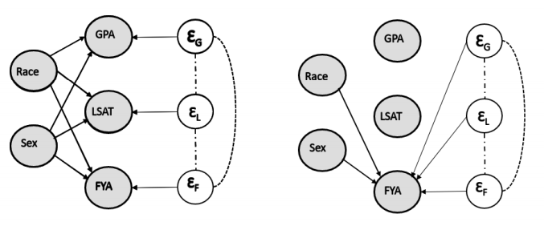
Counterfactual Fairness
Measure fairness from the perspective of causes of bias
P[C_{{A← 0}}=c|X, A=a]=P[C_{{A← 1}}=c|X, A=a]
A counterfactual value replaces the original value of the sensitive attribute which propagates through the causal graph
In practice it is difficult to determine what the causal graph should look like and or which features to use in the graph

Slide 37
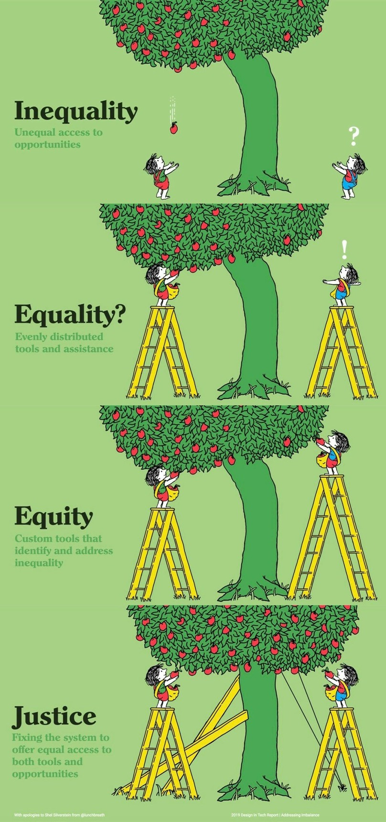
Individual Fairness
Formulation
Similar individuals should be treated similarly
Let Δ(O) to be the space of the distribution over measure space O. Let M:X→ Δ(O) maps each individual to a distribution of outcomes D(M(X),M(X’))≤ d(X,X’)
Limitations
Hard to determine what is an appropriate metric function to measure the similarity of two inputs
Hard to determine which features to use to determine similarity
Notes:
where X, X’ ∈ Rᵈ are two input feature vectors, and D and d are metric functions over the input space and the output space respectively

Slide 38
Type | Description | Formulation | Motivation | Flaws
Unawareness | Do not include the sensitive attribute as a feature in the training data | C=c(x, A) = c(X) | Intuitive, easy to use and legal support (disparate treatment) | There can be many highly correlated features(e.g. neighborhood) that are proxies of the sensitive attribute(e.g. race)
Demographic Parity / Independence / Statistical Parity | The outcomes must be equal | C is independent of A: P₀ [C = c] = P₁ [C = c] ∀ c ∈ {0,1} | Legal Support: “four-fifth rule” prescribes that a selection rate for any disadvantaged group that is less than four-fifths of that for the group with the highest rate. | Ignores any possible correlation between Y and A e.g., rules out perfect predictor C=Y when base rates are different (i.e. P₀ [Y=1] ≠ P₁ [Y=1]) laziness: if we hire the qualified from one group and random people from the other group, we can still achieve parity
Equalized odds / Separation / Positive Rate Parity | Different groups deal with similar odds | C is independent of A conditional on Y: P₀ [C = r | Y = y] = P₁ [C = r | Y = y] ∀ r, y | Optimality compatibility: C=Y is allowed. Penalize laziness: it provides incentive to reduce errors uniformly in all groups. | It may not help closing the gap between two groups
Predictive Rate Parity / Sufficiency | The performance of the predictive model should be the same for different groups | Y is independent of A conditional on C: P₀ [Y = y| C= c] = P₁ [Y = y| C= c] ∀ y, c ∈ {0,1 | Optimality compatibility: C=Y satisfies Predictive Rate Parity. Equal chance of success(Y=1) given acceptance(C=1) | It may not help closing the gap between two groups
Individual Fairness | similar individuals should be treated similarly | D(M(X),M(X’))≤ d(X,X’) | Rather than focusing on group, as individuals, we tend to care more about the individuals. Besides, individual fairness is more fine-grained than any group-notion fairness | It is hard to determine what is an appropriate metric function to measure the similarity of two inputs
Counterfactual Fairness | How do the outcome change if the values of the sensitive variables change | P[C_{A← 0}=c|X, A=a]=P[C_{A← 1}=c|X, A=a] | Counterfactual fairness provides a way to check the possible impact of replacing only the sensitive attribute | The idea is very ideal. In practice, it is hard to reach a consensus in terms of what the causal graph should look like and it is even harder to decide which features to use
Notes:
Fairness in ML has been an area of active research for the last few years. Late 2000s to late 2010s We will focus on definitions as they relate to healthcare, that said we will not
Going deeper into the types of fairness we can start to study the foundations systematically. For example, due to the Unawareness bias, eliminating sensitive attributes from training data does not guarantee that highly correlated features will not act as proxies.
Similarly, it may not be easy to accomplish predictive rate parity or sufficiency for multiple cohorts in the dataset. <CLICK>
Unawareness: excluding race from a model that predicts outcomes following acute MI
Demographic parity: ensure positive rates (I.e. rates of intervention) are the same across groups defined by race
Equalized odds:
The limitation of this weaker notion is that we can trade false positive rate of one group for false negative rate of another group.
Predictive parity:
Individual fairness:
Counterfactual fairness: if the black man had been white, what services would have been offered

Slide 39
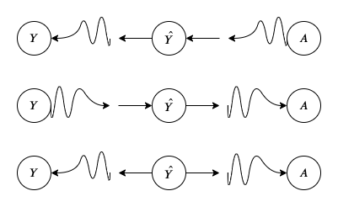
Impossibility Theorem of Fairness (in ML)
No more than one of the three fairness metrics of demographic parity, predictive parity and equalized odds can hold at the same time for a well calibrated classifier and a sensitive attribute [Kleinberg et al 2016; Chouldechova 2017]
it is impossible for a single data generation processes to satisfy all three group fairness metrics [Karthik S 2020]

Slide 40
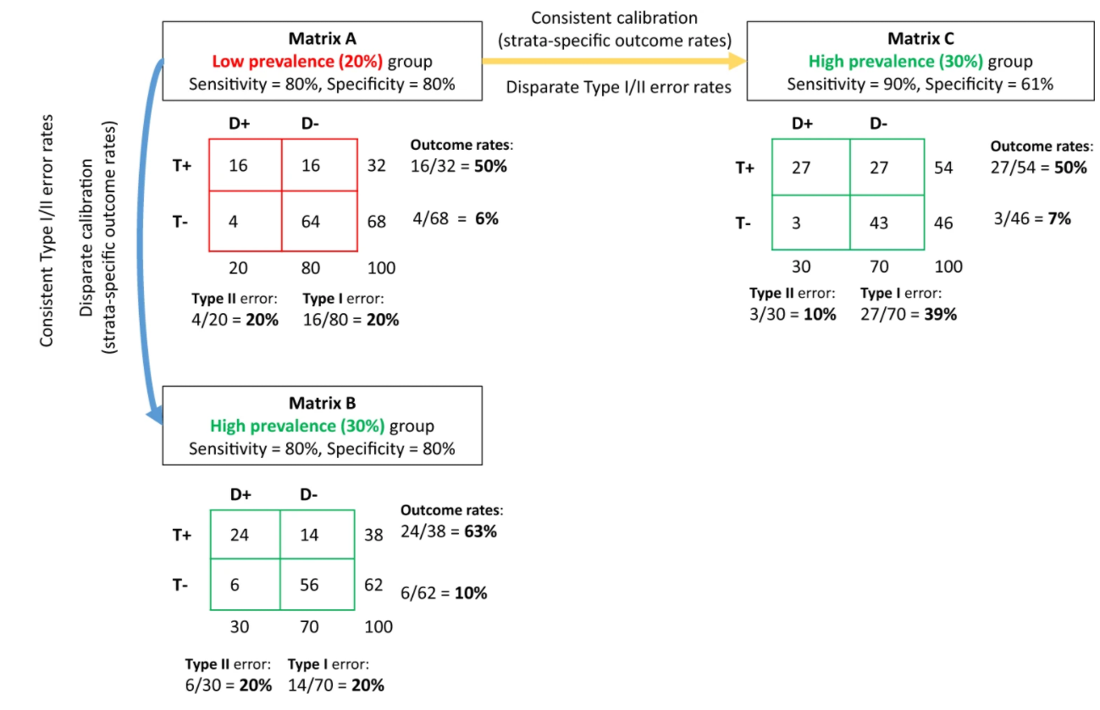
Impossibility Theorem Illustrated
[Paulus and Kent 2020]
Notes:
For two groups with different outcome rates, a predictive test can have consistent error rates or consistent calibration but not both. We present outcomes using coarsened prediction scores, thresholded to divide the population (N = 100) into low and high risk strata. Confusion matrices for a low prevalence group with a 20% outcome rate (Matrix A, red) and a high prevalence group with a 30% outcome rate (Matrices B and C, green) are shown. For the low prevalence group, a predictive test with an 80% sensitivity and specificity identifies a high risk (test+) strata with an outcome rate of 50% (i.e., the positive predictive value) and a low risk (test−) strata with an outcome rate of ~6% (i.e., the false omission rate). However, as shown in Matrix B, the same sensitivity and specificity in the higher prevalence group gives rise to outcome rates of ~63% and ~10% in the high and low risk-strata, respectively. This violates the criterion of test fairness, since the meaning of a positive or negative test differs across the two groups. Holding risk-strata specific outcome rates constant would require a higher sensitivity and lower specificity (Matrix C). This violates the fairness criteria of equalized error rates. For example, the Type I error rate (i.e., the false positive rate) would almost double from 20% in the low prevalence population to ~39% in the higher prevalence population. The diagnostic odds ratio was fixed at ~16 across this example, whole numbers are used to ease interpretation.

Slide 41
Impossibility Theorem of Privacy & Fairness
It is not possible for a classifier to have differential privacy and satisfy group fairness conditions
Kuppam et al. empirically show privacy-fairness. For multiple settings and using census data to which noise has been added to demonstrate how adding noise to achieve differential privacy can adversely affects fairness for minority groups
“Even under a very simple binary classification setting no learning algorithm that is -differentially private (for any ≥ 0) and that is guaranteed to output a fair classifier (for any reasonable notion of fairness) can have non-trivial accuracy”
[Cummings et al 2019; Kuppam et al 2019; Agarwal 2020]

Slide 42
Impossibility of Fairness and Calibration
It is not possible to satisfy any major conditions of calibration and fairness simultaneously. Major notions of Calibration and Fairness
Group Calibration: For each group t, and each bin b with associated score v_{b}, the expected number of people from group t in b who belong to the positive class should be a v_{b} fraction of the expected number of people from group t assigned to b
Negative Class Balance: Requires that the average score assigned to people across groups belonging to the negative class should be the same
Positive Class Balance: Requires that the average score assigned to people across groups belonging to the negative class should be the same
[Kleinberg et al 2016]
Notes:
To take one simple example, suppose we want to determine the risk that a person is a carrier for a disease X, and suppose that a higher fraction of women than men are carriers. Then our results imply that in any test designed to estimate the probability that someone is a carrier of X, at least one of the following undesirable properties must hold: (a) the test’s probability estimates are systematically skewed upward or downward for at least one gender; or (b) the test assigns a higher average risk estimate to healthy people (non-carriers) in one gender than the other; or (c) the test assigns a higher average risk estimate to carriers of the disease in one gender than the other. The point is that this trade-off among (a), (b), and (c) is not a fact about medicine; it is simply a fact about risk estimates when the base rates differ between two groups. [Kleinberg et al 2016]
A first basic goal in this literature is that the probability estimates provided by the algorithm should be well-calibrated
A second goal focuses on the people who constitute positive instances (even if the algorithm can only imperfectly recognize them): the average score received by people constituting positive instances should be the same in each group. We could think of this as balance for the positive class

Slide 43
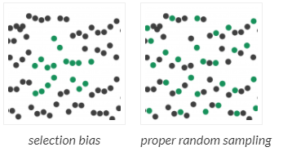
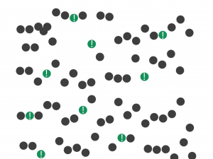
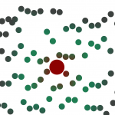
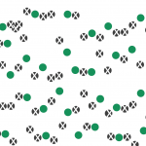
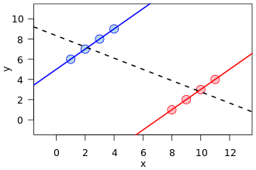
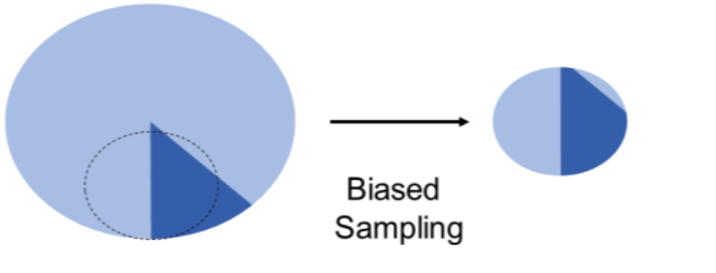
Data Biases: Statistical Biases
Selection Bias
Self-Selection Bias
Observer Bias
Survivorship Bias
Simpson’s Paradox
Sampling Bias
Cause Effect Bias
[Crawford 2017; Gebru et al 2018]
Notes:
Images from https://data36.com/statistical-bias-types-explained/

Slide 44
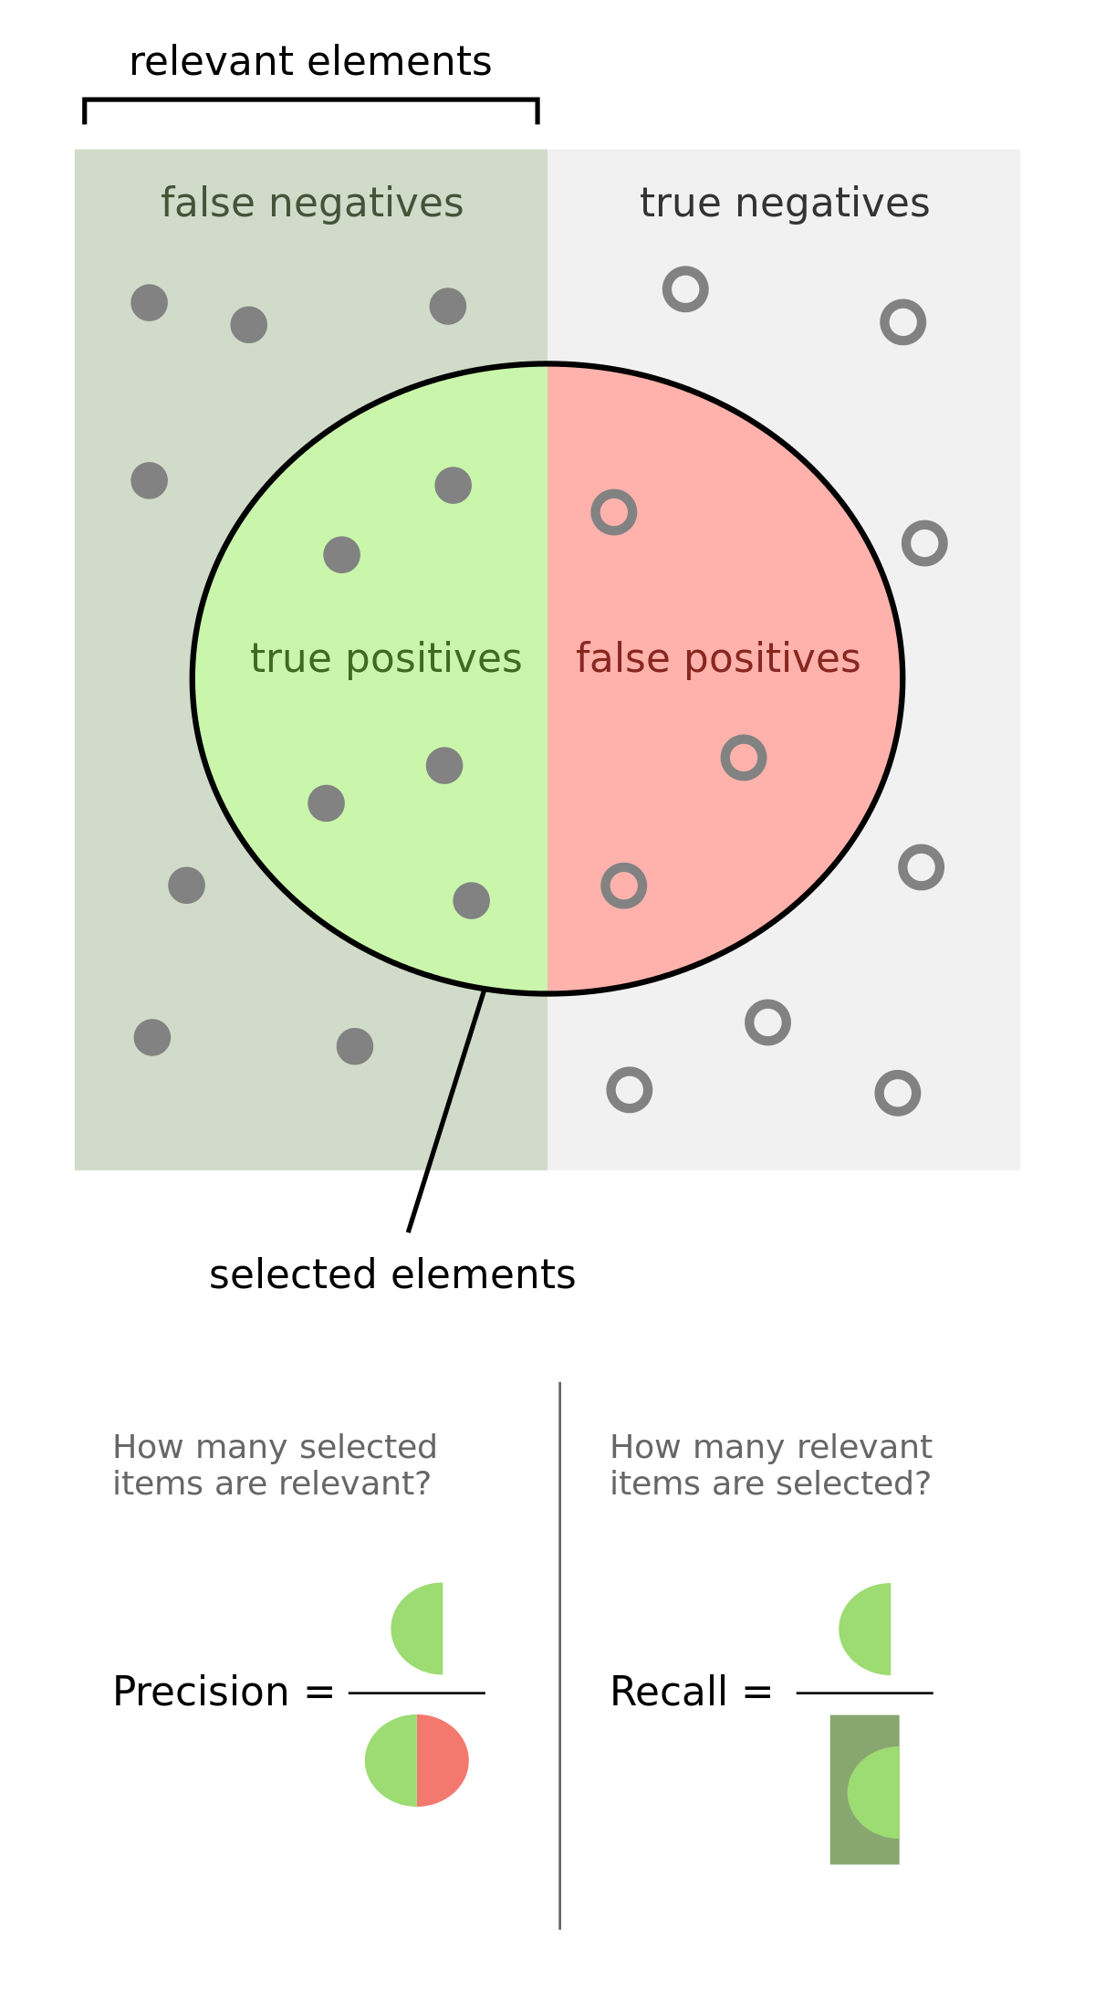
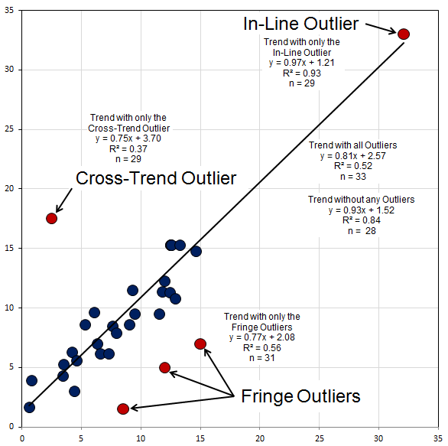
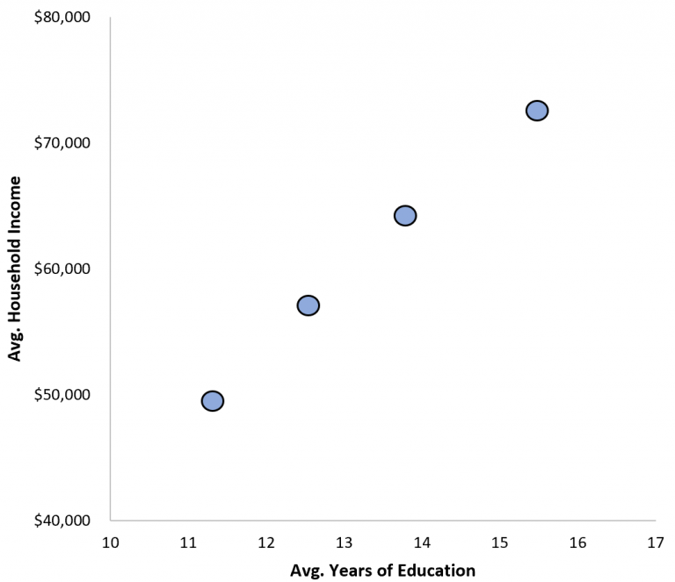
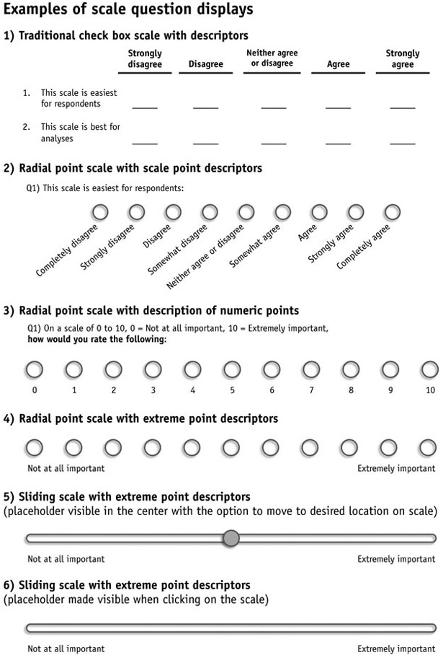
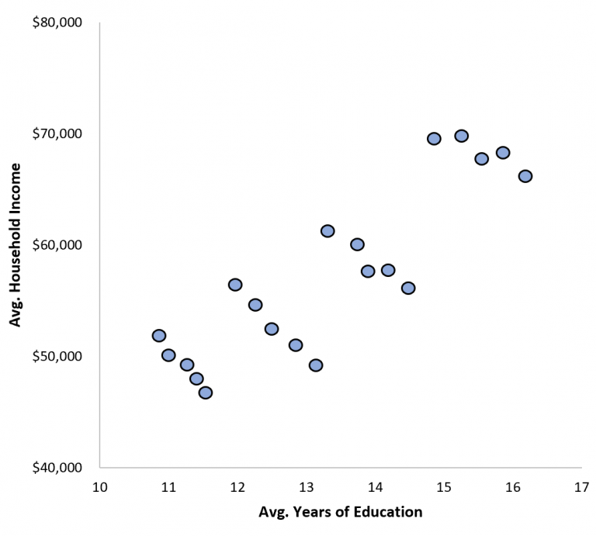
Data Biases: Statistical Biases
Evaluation Bias
Aggregation Bias
Outlier Bias
Response Bias
Notes:
https://www.datasciencecentral.com/profiles/blogs/23-types-of-bias-in-data-for-machinelearning-and-deeplearning
https://medium.com/stats-with-cats/o-u-t-l-i-e-r-s-b90138dfbed6

Slide 45
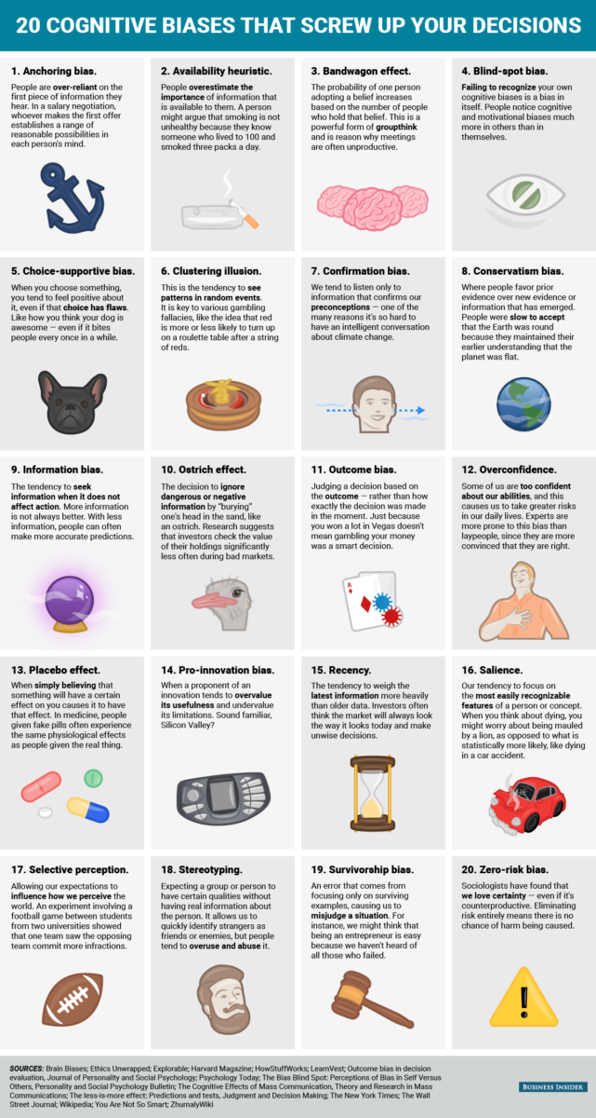
Cognitive Biases
Notes:
https://www.datasciencecentral.com/profiles/blogs/23-types-of-bias-in-data-for-machinelearning-and-deeplearning

Slide 46
Bias: Outcomes & Clinical Perspective
Model Performance
Allocation of Services
Clinical Outcomes
Equal Outcomes
Equal Performance
Equal Allocation
[Rajkomar et al 2018]

Slide 47
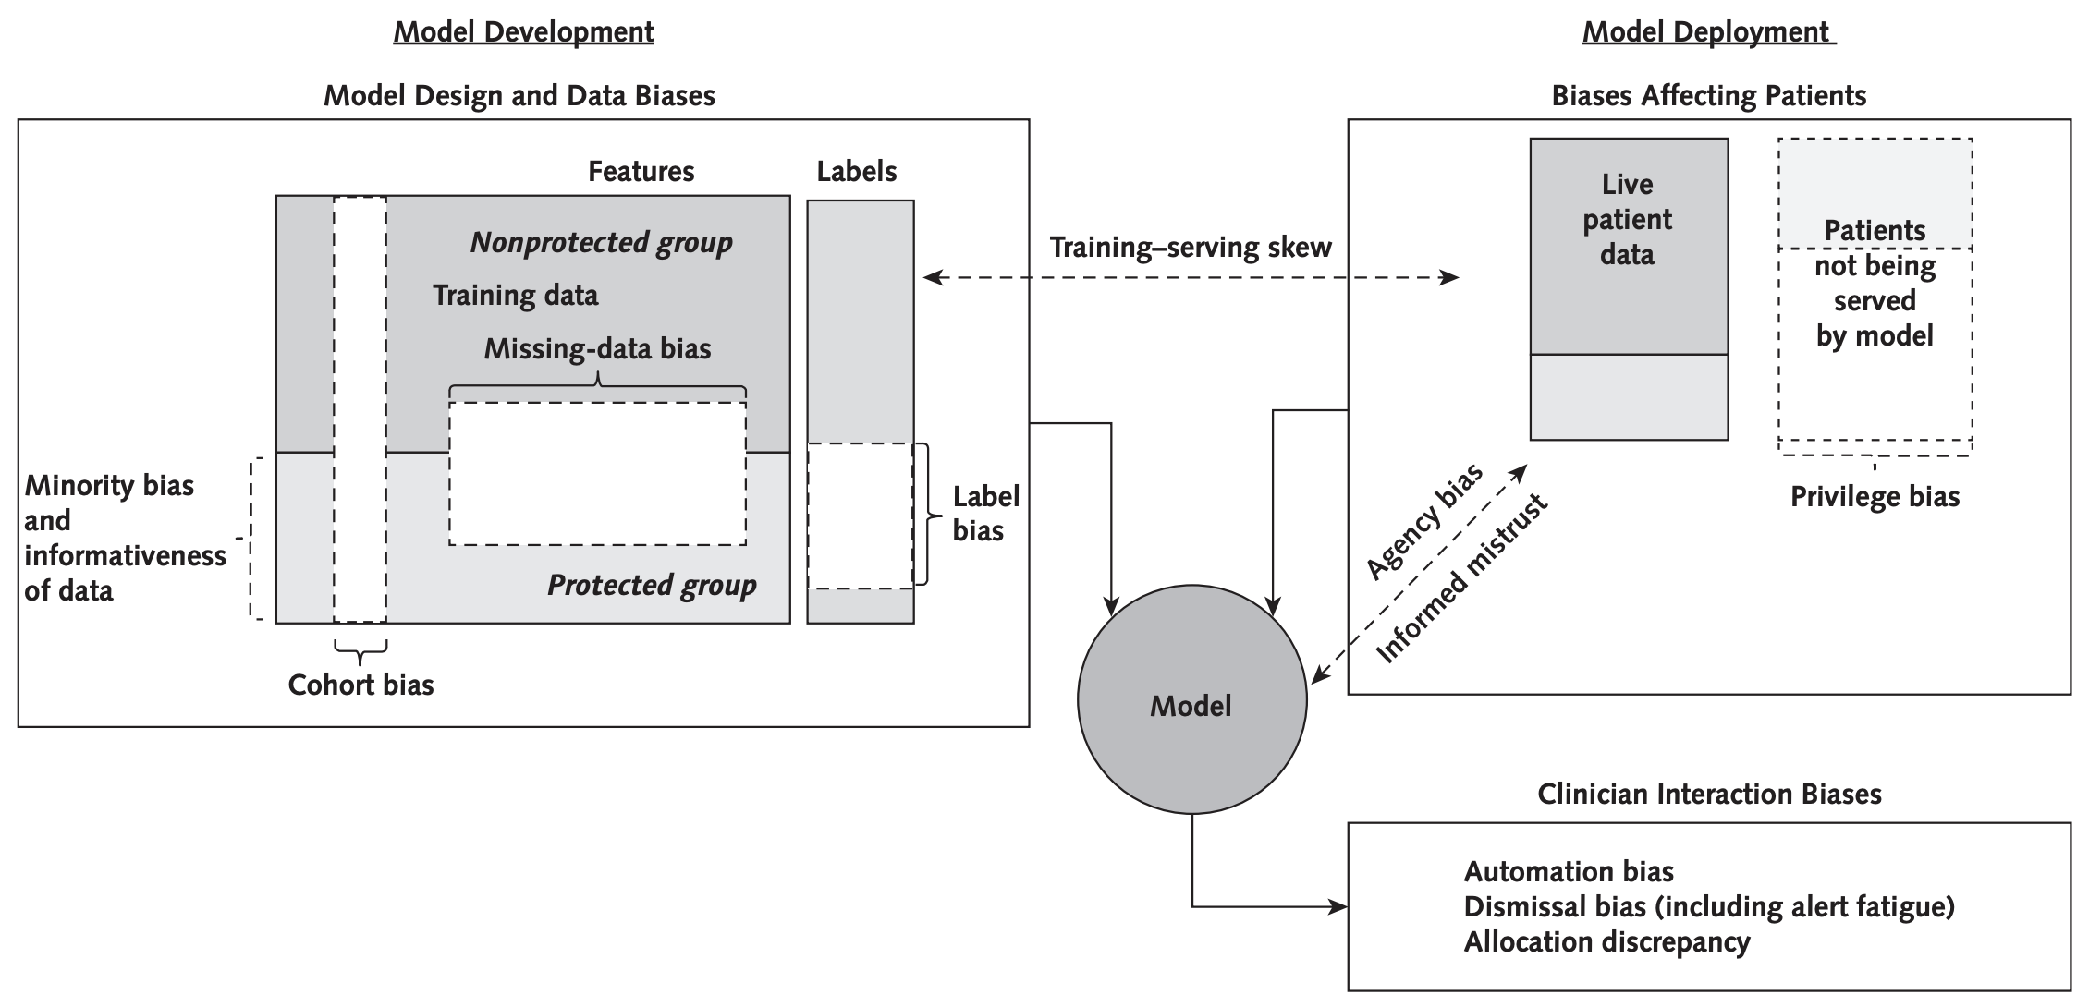
How Biases in Healthcare are Interrelated
[Rajkomar et al 2018]

Slide 48
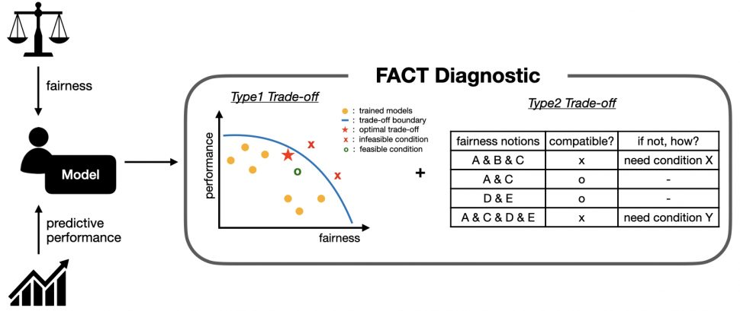
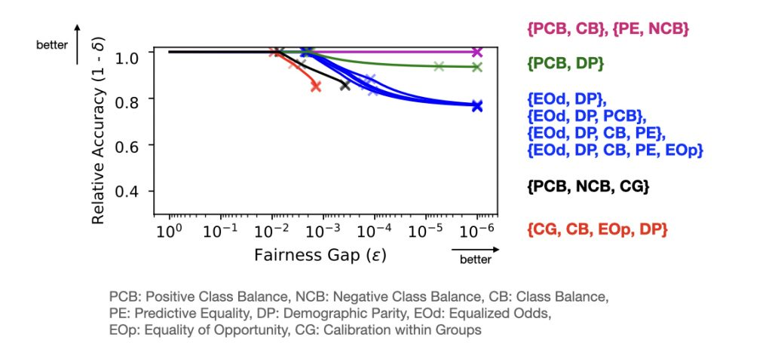
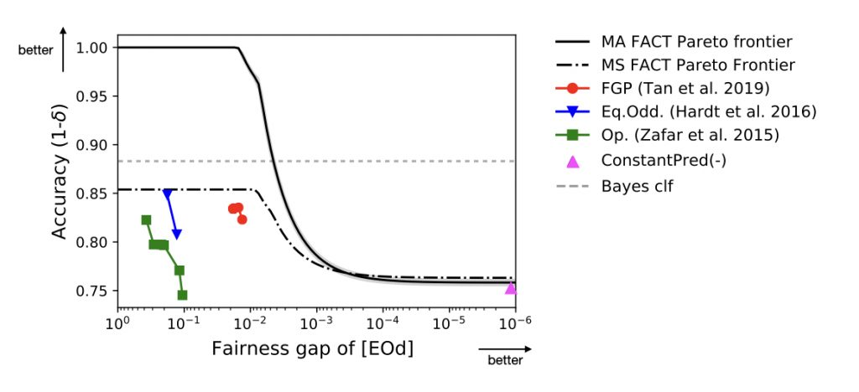
Fairness vs. Performance Trade-off
Predictive performance of a model depends on data, the algorithm, and selected hyperparameters
In general, fairness negatively impacts performance because it diverts the objective from accuracy only to both accuracy and fairness
Trade-off are also present between the different notions of group fairness in conjunction with model performance
We can define these trade-off as an optimization problem so that theoretical results for limits of trade-off are possible
[Dutta et al 2020; Liu et al 2020; Kim et al 2020]

Slide 49
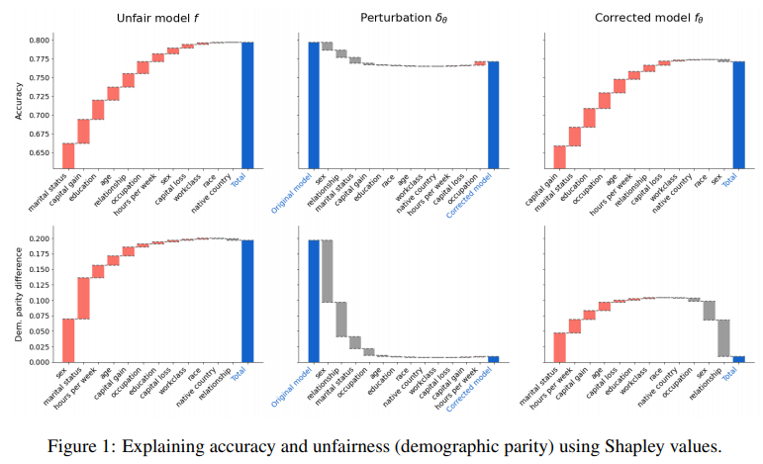
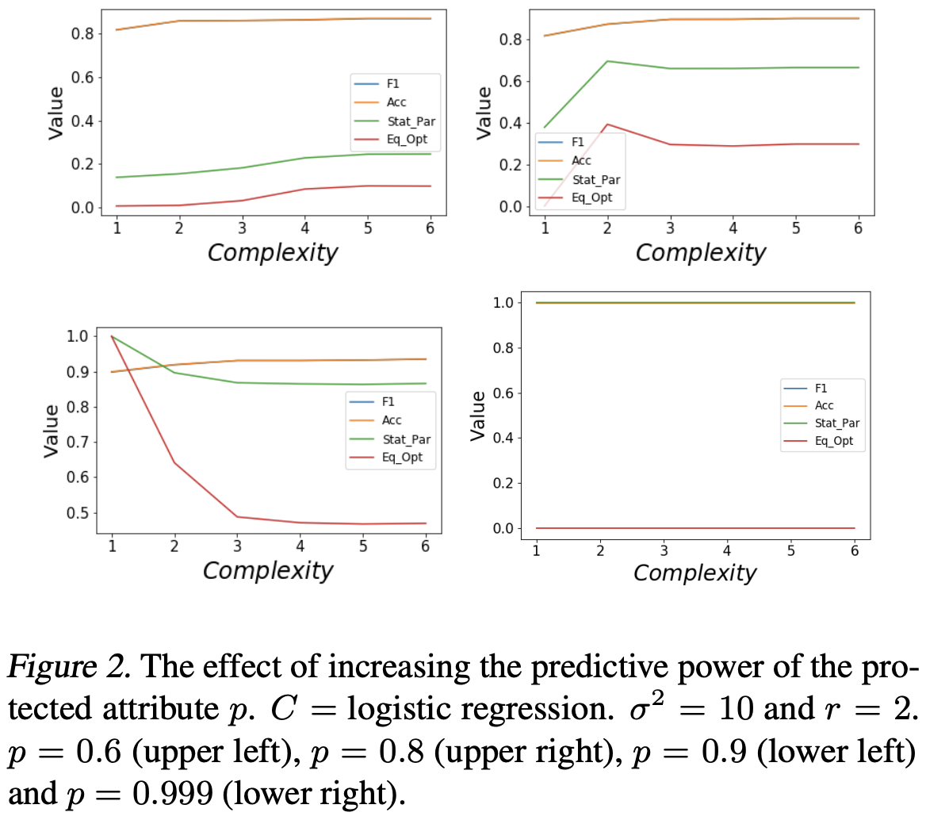
Fairness vs. Explainability Trade-off
The relationship between interpretability and fairness is complex
Follow four different trends depending on the correlations between protected, non-protected attributes and class labels
Interpretability-fairness trade-offs do not depend on group imbalance
Global Shapley values can be interpreted as each feature’s marginal contribution to the overall demographic disparity in the model
SHAP can be modified to explain fairness
[Jabbari et al 2020; Begley et al 2020]

Slide 50
Fairness vs. Explainability Trade-off
Explainability of ML models intends to bring about greater scrutiny of models and thus the possibility of fair and equitable models
However, simplification of models may also bring about performance degradation as well as less fair models [Kleinberg and Mullainathan 2019]
The trade-off in healthcare is thus four way: Fairness vs. Performance vs. Explainability vs. Risk
Domain specific guidance should be used to help navigate these complex trade-offs
Fairness
Performance
Risk
Explainability

Slide 51
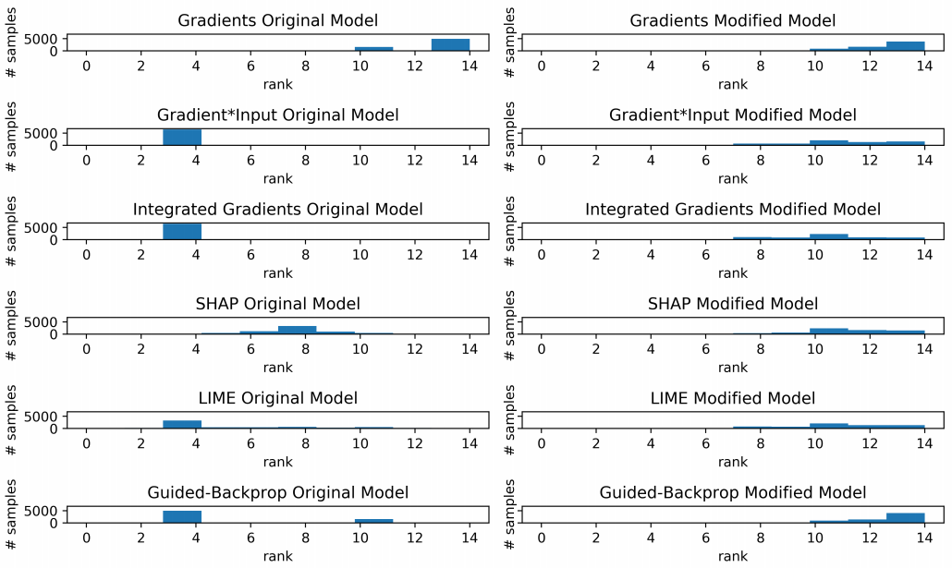
Limits of Fairness via Explanations
Dimanov et al. showed that existing explainability models like LIME, SHAP etc. methods are not suited for fairness
The authors retrained a model with an additional penalty term corresponding to the influence the protected attribute has on the output
The explanation for that feature can be suppressed without substantially affecting the model predictions
Thus, feature importance of the protected attribute is a poor measure of fairness. [Dimanov et al. 2020]
Importance ranking histograms for gender as the sensitive feature the original (left) and modified (right) models.
Notes:
Each histogram represents the ranking across the test set assigned by the designated feature importance method. A higher ranking number (further to the right) indicates smaller feature importance. Observe that the modified model has successfully shifted the ranking for all explanation methods.

Slide 52
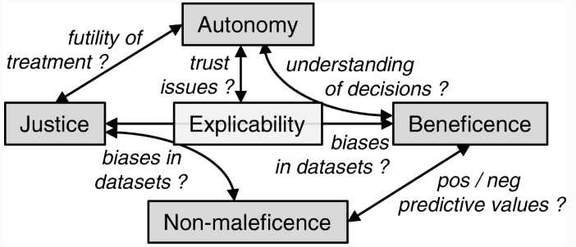
Fairness Trade-offs & Beneficence
Beneficence: An ethical principle that providers must do everything they can to benefit the patient
The removal/reduction of bias could possibly reduce predictive performance and undermining the principle of beneficence
Challenge: How do we simultaneously reduce bias and maintain satisfactory model prediction performance (upholding beneficence)?
[Beil et al 2019]

Slide 53
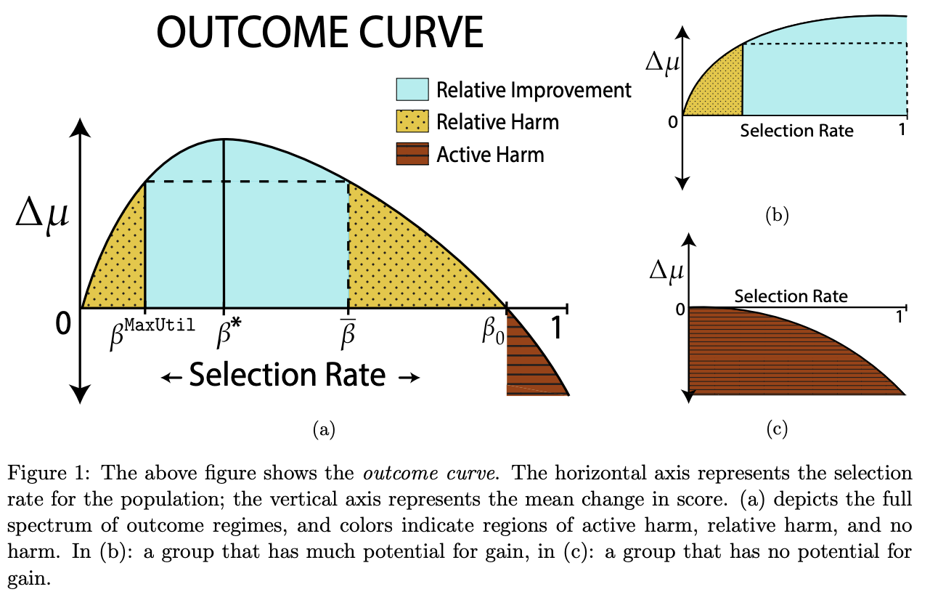
Long Term Impact of Fair ML
Under what circumstances does fairness criteria promote the long-term well-being of protected groups over time
In standard classification setting such scenarios are not considered
Even in one-step feedback models, common fairness criteria do not promote improvement over time
In many scenarios in fact cause harm in cases where an unconstrained objective would not
Most models that aim to predict long term impacts of fairness are brittle w.r.t specific modeling assumptions
[Liu et al 2020]
Notes:
Model brittleness: they point to the need to consider long term dynamics, but do not provide robust guidance for how to navigate them.

Slide 54
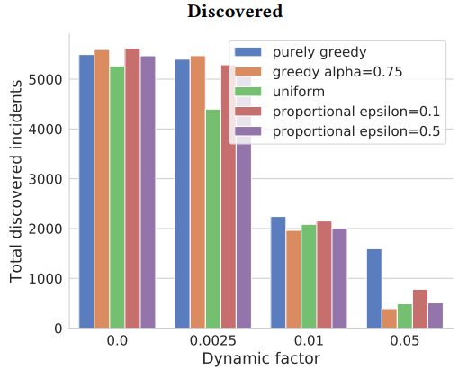
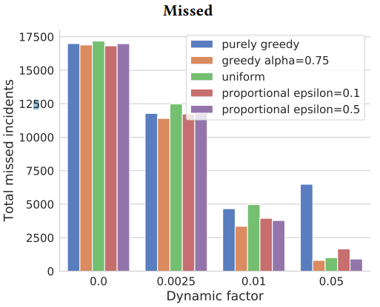
Long Term aspects of Fair ML
Long term dynamics in any system are hard to assess
The use of simulation for studying fairness has been proposed as a way to address this structurally
Work by D’Amour et al showed that “the long-term results offered by simulation supports qualitatively different (though not incompatible) fairness conclusions from those obtained before”
Similar studies for healthcare-based scenarios are lacking
[D’Amour et al. 2020]

Slide 55
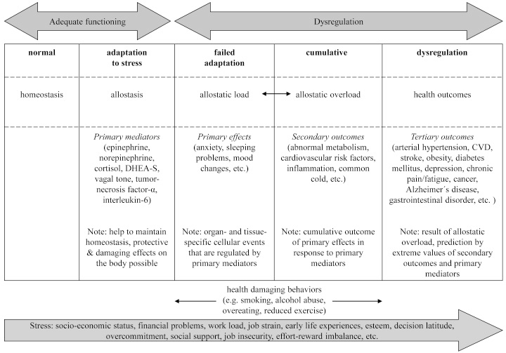
A Lifecycle view of Inequity
Long term consequences of (un)fair decisions can accumulate over time
What is the cumulative effect of discrimination faced by an individual over the course of a lifetime?
What are the effects of discrimination at multiple points of care over the course of decades?
What are the physiologic effects of chronic stressors related to inequity?
[Mauss et al. 2015]

Slide 56
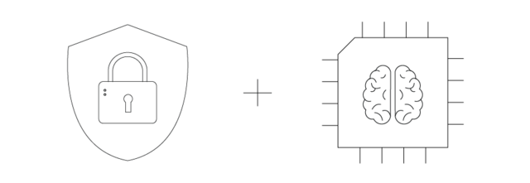
Data: Minority Class, Fairness and Privacy
Problem: For better predictive performance, it is critical to gather data that include minorities and to ensure that these data are not completely subsumed by data from presumed “normative” populations
Conundrum: Data collection in this context would also lead to issues related to confidentiality and privacy e.g., potentially dangerous for subjects
Multi-dimensional Problem: Minority status has multiple dimensions, varies in intensity and impact, and varies changes over time. The simple protected vs. other class framework may not suffice
Notes:
especially as regards disability status, might make collecting these data difficult (for developers) or dangerous (for subjects)

Slide 57
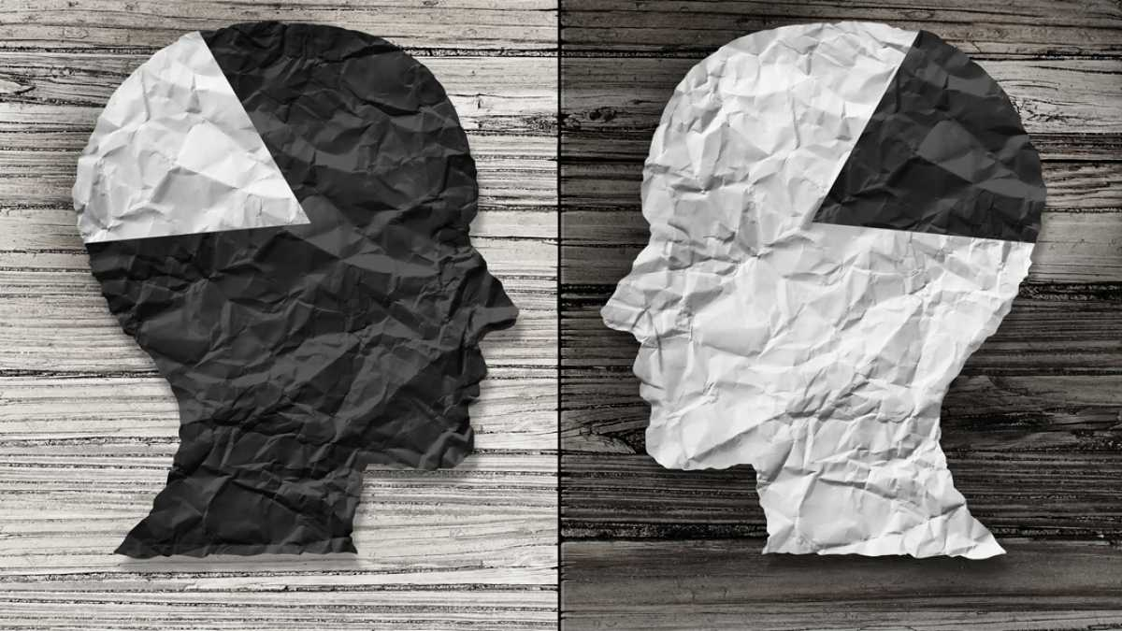
Data: Trouble with Labels
Data: Minority Classes & Generalization
In sub-Saharan Africa, women are diagnosed with breast cancer younger, on average, than are their peers in developed countries, and their disease is more advanced at diagnosis. Diagnostic AI tools trained on mammograms from European women are primed to identify disease in its early stages in older women [Nordling 2019]
Data security and access concerns have been raised about allowing developers to access such data from low-income countries
Notes:
Companies offer to pay for such data, he says, which might tempt cash-strapped national health systems or individual researchers to part with patient data, perhaps without thinking hard about the rights of the those whose data they are sharing. A number of developing countries are introducing data-protection laws, but in those countries where law enforcement is lax, such regulations could be circumvented.

Slide 58
Data: Trouble with Labels
Data: Trouble with Labels
Data labels are generally derived from the HER
Labeling incentives may change as healthcare processes change (e.g., Meaningful Use criteria, HEDIS measures)
Definitions of an outcome may change over time e.g., thresholds that define a disease
Mental health evaluations, psychological assessments, pain assessment by clinicians vs. patients, patient reported outcomes may vary
Racial and sex/gender biased disparities have been observed for pain assessment across multiple studies
Optimizing for the wrong label can lead to biased outcomes

Slide 59
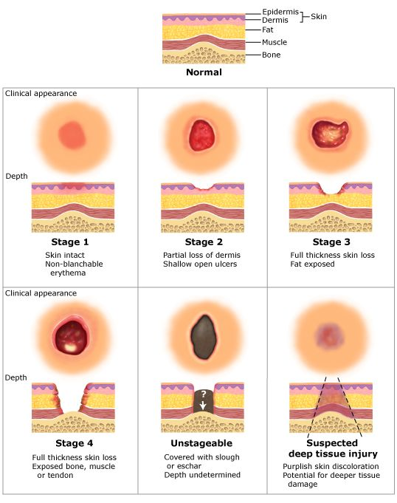
Data: Trouble with Labels: Pressure Injury
“Localized damage to the skin and underlying soft tissue, usually over a bony prominence or related to a medical or other device.” NPUAP
Multiple risk assessment exist for pressure injury (PI). The Braden Scale is the most widely used scale
All measurement scales for PI are highly subjective in nature
Notes:
The injury occurs as a result of intense and/or prolonged pressure, or pressure in combination with shear
Marker of poor overall prognosis
May contribute to premature mortality in some patients
Commonly seen in high-risk populations (elderly and very ill)
Vary by clinical setting, and is a potentially preventable condition

Slide 60
Data: Trouble with Labels: Knee Pain
Notes:
As you can see a significantly larger share of people of color or those with low income or education report being in severe pain in the U.S. A plausible explanation for this might be that such people are more likely to suffer from painful conditions: for example, individuals with a high school or less are 60% more likely to suffer from arthritis of the knee compared with people who have graduate degrees.
However, conditioning on such outcomes does not appreciably reduce the “race gap” in pain. For example, you can look at two people with very similar x-rays: the patterns in the above figure still hold at every level of disease severity discerned by medical professionals from the x-ray. There could be explanations for this, too: for example, stress can make an ailment more painful; there could be differences in access to/uptake of therapies to reduce pain, etc.
But, let’s take a step back for a second. What do we mean when we say that there is a persistent “race gap” in pain? Let’s zoom in on the osteoarthritis case:
Someone complains of pain in their knee
Doctor orders an x-ray and finds it to “look normal.”
Doctor decides that pain must have another cause.
Maybe the doctor is wrong: where does the checklist by which he scores/grades the x-ray come from? In this case, from two researchers who studied coal miners in Lancashire, England in the 1950s. Those original papers that underlie the objective grading systems used to diagnose knee arthritis today did not mention the race of the subjects – perhaps because there was no heterogeneity along this dimension in the study population. Be that as it may, that’s what doctors use today: a grading scheme based on a 1950s, likely mostly white, English population. Could the doctors be under-diagnosing knee problems among minorities and disadvantaged segments of the population? Sure
This is where Dr. Obermeyer and co. had a good idea: train the algorithm on the level of pain reported by the patients instead

Slide 61
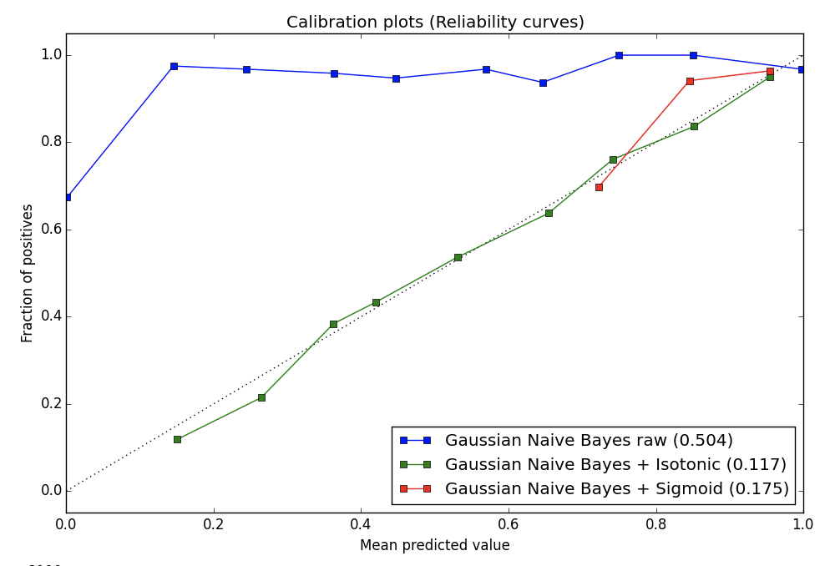
Fairness and Calibration
Calibration: The set of people who receive a predicted probability of p, then fraction p of members of this set should be positive instances [Dawid 1982]
Fairness between two groups G1 and G2 (e.g., Black and white patients) implies that this calibration condition to hold simultaneously for the set of people within each of these groups [Flores et al 2016]
It is not feasible for certain notions of fairness
[Kleinberg et al 2016; Pleiss et al 2017]
Notes:
When feasible, it has a unique optimal solution that can be achieved through post-processing of existing classifiers but is not feasible in practice
Cases in which calibration and relaxed Equalized Odds are compatible, the penalty of equalizing cost is amplified if the base rates between groups differ significantly. This is expected, as base rate differences are what give rise to cost-disparity in the calibrated setting.
Even if fairness is reached in expectation, for an individual case, it may be hard to accept that occasionally consequential decisions are made by randomly withholding predictive information, irrespective of a particular person’s feature representation. In this paper we argue that, as long as calibration is required, no lower-error solution can be achieved.
It is impossible to achieve calibration while also satisfying Equalized Odds. Even if the Equalized Odds conditions are relaxed substantially – requiring only that weighted sums of the group error rates match – it is still problematic to also enforce calibration.
Seeking equality with respect to a single error rate (e.g. false-negatives, as in the income prediction experiment) will necessarily increase disparity with respect to the other error. This may be tolerable (in the income prediction case, some employees will end up over-paid) but could also be highly problematic (e.g. in criminal justice settings). Finally, we have observed that the calibrated relaxation is infeasible when the best (discriminatory) classifiers are not far from the trivial classifiers (leaving little room for interpolation). In such settings, we see that calibration is completely incompatible with an equalized error constraint. In summary, we conclude that maintaining cost parity and calibration is desirable yet often difficult in practice. Although we provide an algorithm to effectively find the unique feasible solution to both constraints, it is inherently based on randomly exchanging the predictions of the better classifier with the trivial base rate.
However, this simple post-processing method is fundamentally unsatisfactory: although the post-processed predictions of our information-withholding algorithm are “fair” in expectation, most practitioners would object to the fact that a non-trivial portion of the individual predictions are withheld as a result of coin tosses – especially in sensitive settings such as health care or criminal justice.

Slide 62
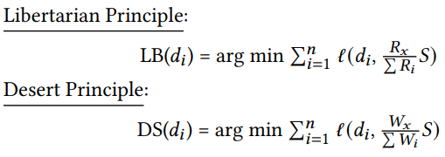
Normative Moral Principles and ML Fairness
Since it is not possible to satisfy every fairness metric, moral and political philosophy are required for design choices Consequentialist Approaches focuses on each potential distribution and its effects
Deontological Approaches evaluate distributions based on rights
An Egalitarian approach confers equal rights, and thus equal shares, to every member of the population
[Binns 2018; Leben 2020]

Slide 63
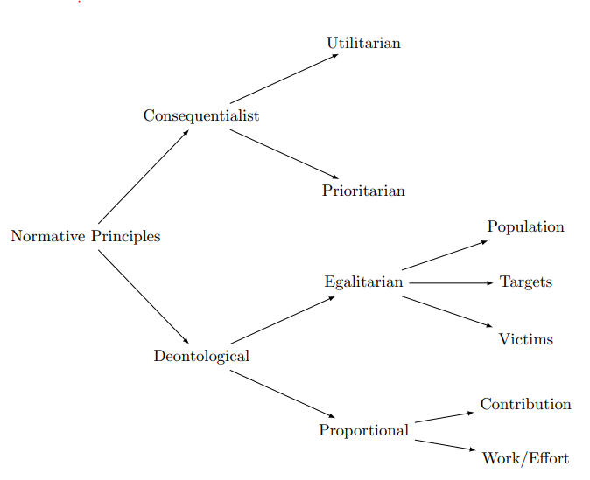
Deontic Justice & Fair ML in Healthcare
Deontic Justice: It is not just the state of affairs of unfairness that matters but also what were the conditions that led to that state [Binns 2018]
This requires integrating a perspective from philosophy, history, economics, sociology etc.
Once identified, where should the locus of responsibility be? focus on improving outcomes
When is a particular mistreatment of a protected group worse than the mistreatment of the protected group?
Modeling strongly coupled complex systems is hard!

Slide 64
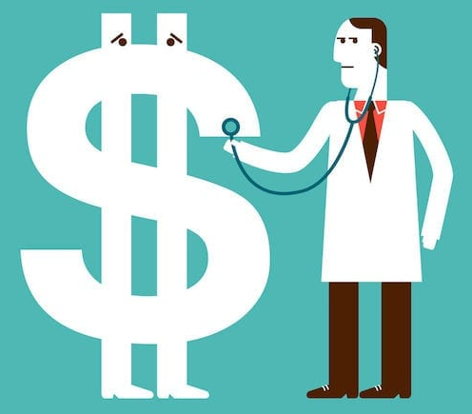
Luck Egalitarianism & Fair ML in Healthcare
What type of inequalities are acceptable?
Luck Egalitarianism: Allow inequality in cases which result from people’s efforts and risk taking and do not allow it in cases where it is because of brute luck (skin color, born with debilitating health condition) [Arneson 1989]
Coupled nature of social units: People choices may be limited because they choose to take of sick, elderly, young family members
Free choice are not always free; need to audit systems to determine how stakeholders are being affected?
Notes:
Relevant to a lot of us stuck at home during COVID

Slide 65
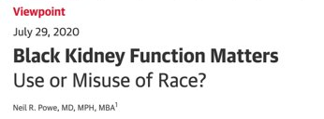
Race Correction and Fair ML IN Healthcare
Race corrections i.e., different risk scoring adjustments based on race, are made in many healthcare models which also seep into ML models
Example: Spirometer is widely used across the world for the diagnosis and management of many respiratory diseases
The notion that black and white lungs differ goes back to Thomas Jefferson who posited differences between slaves and freeman’s lung functions [Braun 2015]
Spirometer based studies were used to justify differences between Europeans, Asians and Africans by Plantation owners and colonial administrators [Braun 2014]
Such race corrections are now part of computer models (ML or otherwise)

Slide 66
Operationalizing Fairness in Healthcare ML

Slide 67
Being good is easy, what is difficult is being just.
- Victor Hugo

Slide 68
Bias Mitigation Strategies for ML Models
Pre-Processing | In-Processing | Post-Processing
Reweighing Optimized Preprocessing Learning Fair Representations Disparate Impact Remover | Adversarial Debiasing Prejudice Remover | Equalized Odds Postprocessing Calibrated Equalized Odds Postprocessing Reject Option Classification
Notes:
https://dzone.com/articles/machine-learning-models-bias-mitigation-strategies

Slide 69
Fair ML via Pre-Processing
Reweighing: Generate weights for the training data for each protected variable to ensure fairness before classification
Optimized Preprocessing: Learn probabilistic transformations that minimally transforms the data while controlling for discrimination and limiting distortion in individual data samples
Learning fair representations: Find latent representations that encodes the data well while obfuscating information about protected attributes
Disparate impact remover: Edit features to increase group fairness while preserving rank-ordering within groups

Slide 70
Fair ML via In-Processing
Adversarial Debiasing: Learn a classification model that simultaneously maximizes predictive performance and reduces an adversary's ability to determine the protected attribute from the predictions. Since the approach minimizes information that can be used to determine proxies for discrimination information w.r.t. an adversary and thus leads to a fair classifier
Prejudice removal via Regularization: Add a discrimination-aware regularization term to the learning objective

Slide 71
Fair ML via Post-Processing
Equalized odds postprocessing: Change target variables with certain probabilities (via linear programming) to optimize equalized odds
Calibrated equalized odds postprocessing: Optimize calibrated classifier scores to find probabilities with which to change target variables with an equalized odds objective
Reject option classification: For a confidence band around the decision boundary with the highest uncertainty, give favorable outcomes to unprivileged groups and unfavorable outcomes to privileged groups in

Slide 72
Outcome based fairness metrics revisited
Fairness metrics like group fairness or even individual fairness optimize for immediate outcomes e.g., diagnosis, risk of readmission etc.
Downstream effects are much harder to quantify
The purpose of fairness metrics is to quantify the extent of the problem which is not equivalent to solving the problem
Impossibly theorems do not imply that fairness in machine learning is not impossible but rather it is constrained by real world limitations

Slide 73
Cost Optimization is not need based optimization
Algorithm scores are a key input to decisions about future enrollment in care coordination programs
Less-healthy Blacks are scored at similar risk scores to more-healthy Whites which leads to disparities in program screening
Algorithm’s prediction on health needs is really a prediction on health costs
At a given level of health (measured by number of chronic illnesses), Blacks generate lower costs than Whites on average ($1,801 less per year, holding constant the number of chronic illnesses) [Obermeyer et al 2019]
Notes:
We quantify this by simulating a counterfactual world with no gap in health conditional on risk. Specifically, at some risk threshold a, we identify the supramarginal White patient (i) with Ri > a and compare this patient’s health to that of the inframarginal Black patient (j) with Rj < a. If Hi > Hj , as measured by number of chronic medical conditions, we replace the (healthier, but supramarginal) White patient with the (sicker, but inframarginal) Black patient. We repeat this procedure until Hi = Hj, to simulate an algorithm with no predictive gap between Blacks and Whites.

Slide 74
Healthcare Needs ≠ Healthcare Costs
Black patients generate very different kinds of costs: Fewer inpatient surgical and outpatient specialist costs, and more costs related to emergency visits and dialysis
“These results suggest that the driving force behind the bias we detect is that Black patients generate lesser medical expenses, conditional on health, even when we account for specific comorbidities”
Result: Optimizing for costs does not always lead to fair outcomes
[Obermeyer et al 2019]

Slide 75
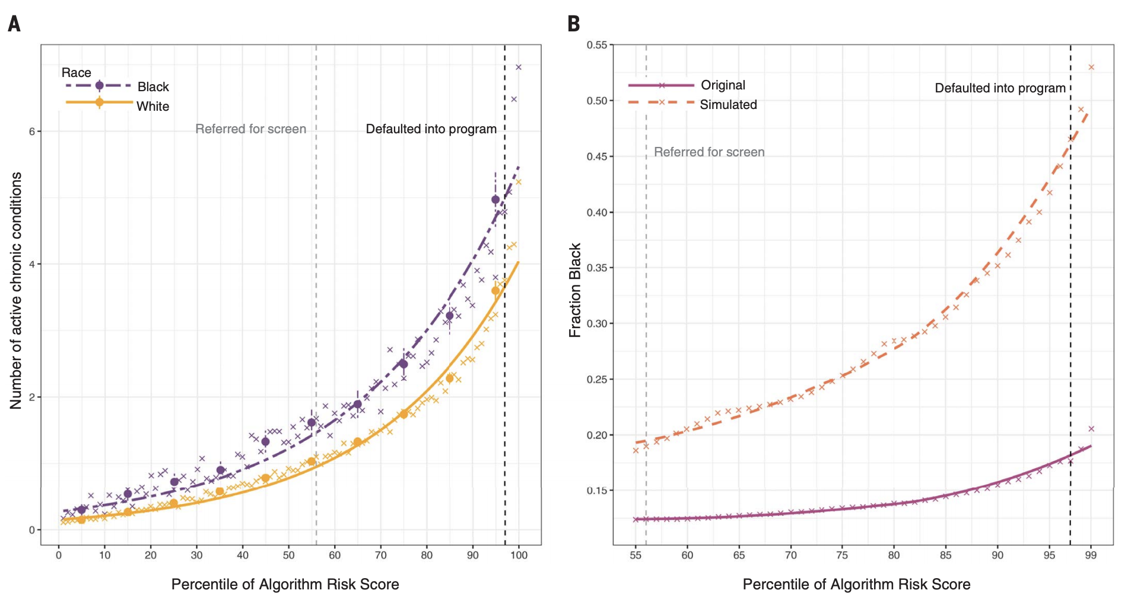
Treatment Effect is not monotonic
The predicted risk of some future outcome e.g., healthcare needs is widely used to target policy interventions under the assumption that the treatment effect is monotonic
However, this is however not always true
At the same level of algorithm-predicted risk, Blacks have significantly more illness burden than Whites
Calculate an overall measure of health status, the number of active chronic conditions [or “comorbidity score,” a metric used extensively in medical research to provide a comprehensive view of a patient’s health] by race, conditional on algorithmic risk score.
[Obermeyer et al 2019]
Notes:
a large academic hospital, we identified all primary care patients enrolled in risk-based contracts from 2013 to 2015. Our primary interest was in studying differences between White and Black patients

Slide 76
Stakeholder Trade-off
Fairness may also require trade-off between different stakeholders
Optimizing for one sub-population may de-optimize for another population
Even within the majority population there may be sub-groups which are not explicitly defined but which are vulnerable nonetheless
Example: No Show Prediction
What a clinician wants to optimize for may be different from what staff planner may want to optimize for which may be different from what a patient from a marginalized group is optimizing for

Slide 77
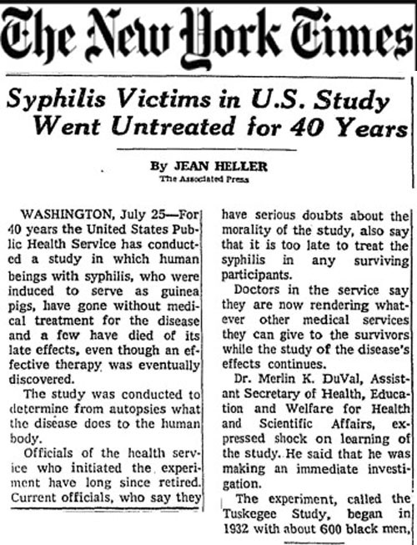
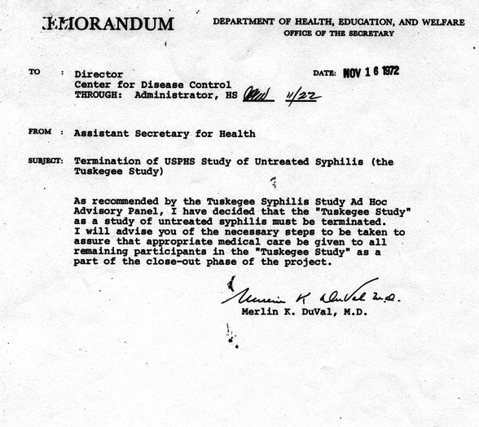
Ethics Gone Wrong: Exploration & Exploitation in Medicine
Notes:
use of placebo in RCT
Tuskeegee airmen study
Pregnancy as a protected class for research. (does this slow learning for women as study subjects

Slide 78
The Problem of Non-Stationarity
Real world data is characterized by non-stationarity. [Jung et al 2015]
Extended versions of ML algorithms can deal with concept drift while being fair
Use older data to predict most recent data
Split by time (non-stationary)
Split randomly (stationary)
Use of one set of patients to predict another set of patients
Split by patient (non-stationary)
If one is interested in “using the model on future data, then it appears that a substantially simpler model is best” [Jung and Shah 2015]
Notes:
Data may change over time and feedback loop may change characteristics of relevant classes

Slide 79
Fairness and Non-Stationarity
Fairness Gain: The fairness gain of an attribute A relative to instances D can be defined as the discrimination reduction in D due to splitting on A where D_{v} v ∈ dom(A) are the partitions induced by A
[Zhang et al 2020]
Notes:
In practice, the discrimination before splitting (i.e., on D) is compared against the discrimination after splitting, by aggregating the weighted discrimination on each resulting subset Dv. Its absolute value is used to capture reverse discrimination, i.e., discriminating against the favored community
The idea of fairness gain (FG) aligns with the idea of information gain (IG) which measures the reduction in entropy resulting from a split; for both FG and IG it holds that the higher the reduction the merrier.
We combine fairness gain and information gain to a joint objective, called fair information gain (FIG), that evaluates the suitability of a candidate splitting attribute in terms of both predictive performance and fairness.

Slide 80
Underspecification and Fairness
Multiple ML models can roughly have the same performance in train-test but can vary wildly in performance when deployed
“An ML pipeline is underspecified if there are many predictors f that a pipeline could return with similar predictive risk”
[D'Amour et al 2020; Marx et al 2020]
Notes:
(different inductive bias but similar performance)
Some stress tests are also at odds with each other: models that were good at recognizing pixelated images were often bad at recognizing images with high contrast, for example. It might not always be possible to train a single model that passes all stress tests

Slide 81
Underspecification and Fairness
Stress tests (contrived testing conditions) can be done to determine how well will the models do in different scenarios
Implications for Fairness: Predictive Multiplicity and underspecifiation can impact fairness and lead to unfair models
[D'Amour et al 2020; Marx et al 2020]

Slide 82
AI Fairness Obfuscating Fair outcomes?
Due to complexity of real-world healthcare use cases the predictors may not always map onto real world causal relationships
Fairness in predictions is not the same as guaranteeing fair outcomes with respect to a given health condition
If a model’s performance is assessed w.r.t true events (and not just train-test) most notions of model performance suffer
“These discrepancies would only be evident longer term and not at the point-of-care where decisions must be made concerning the care management of patients.”
Fairness as measured by output metrics is insufficient. Real-world downstream effects of decision-making must be carefully considered
[McCradden et al 2020]
Notes:
Empirically, when attempting to control for the effects of bias within an ML model we may unintentionally obfuscate persistent unfairness. Effectively the algorithmic solution creates a prediction that is based on relationships that do not map the real-world ones. As such, we risk seeing fairness in the predictions and mistaking them for having generated fair outcomes with respect to a given health condition. Moreover, given that the model’s performance is assessed with respect to its ability to track true events, most notions of model performance would suffer. These discrepancies would only be evident longer term and not at the point-of-care where decisions must be made concerning the care management of patients. As such, ‘fairness’ as operationalized by output metrics alone is insufficient; the downstream, real-world consequences must be carefully considered

Slide 83
From High resource to Low resource environments
A practical limitation of deploying machine learning models is the shift in performance observed when moving from high resource to low resource environments
What are the regulatory obligations and resource support needed to ensure that translation of technology across high-to-low resource contexts happens
Most aspects of responsible AI like fairness, explainability, and performance usually break down
[Gargeya 2017]

Slide 84
Generalization problems in moving from High resource to low resource environments
Deployment of Google’s Retinopathy tool in low resource environments
Clinics in Google’s study often experienced slower and unreliable connections
Example: In one clinic the internet went out for two hours during eye screening, reducing the number of patients screened by half (from 200 to 100)
Fewer people in this case received treatment because of an attempt to leverage this technology
Notes:
Images with obvious DR but poor quality would be refused by the system, complicating and extending the process. And that’s when they could get them uploaded to the system in the first place:
This causes some images to take 60-90 seconds to upload, slowing down the screening queue and limiting the number of patients that can be screened in a day.
Nurses tried various workarounds but the inconsistency and other factors led some to advise patients against taking part in the study at all

Slide 85
Fairness Gerrymandering (Intersectionality)
Intersectionality: the interconnected nature of social categorizations such as race, class, and gender as they apply to a given individual or group, regarded as creating overlapping and interdependent systems of discrimination or disadvantage [Oxford Dictionary]
Intersectionality is susceptible to (intentional or inadvertent) fairness gerrymandering where a classifier appears to be fair on each individual group, but not for subgroups

Slide 86
Intersectionality in Healthcare ML
Statistical notions of fairness across exponentially (or infinitely) many subgroups, defined by a structured class of functions over the protected attributes
This interpolates between statistical definitions of fairness, and recently proposed individual notions of fairness, but it raises several computational challenges. It is no longer clear how to even check or audit a fixed classifier to see if it satisfies such a strong definition of fairness
The Computational problem of auditing subgroup fairness for both equality of false positive rates and statistical parity is equivalent to the problem of weak agnostic learning (Computationally hard in the worst case)
However, it also suggests that common heuristics for learning can be applied to successfully solve the auditing problem in practice [Kearns et al 2017]

Slide 87
Intersectionality: Differential Fairness
Differential Fairness: A mechanism M(x) is ε-differentially fair (DF) with respect to (A, Θ) if for all θ ∈ Θ with x ∼ θ, and y ∈ Range(M),
Where, s_{i} , s_{j} ∈ A are tuples of all protected attribute values, Θ is a set of distributions θ which could plausibly generate each instance x i.e., regardless of the combination of protected attributes, the probabilities of the outcomes will be similar [Foulds et al 2019]
Work on intersectional fairness in ML is relatively scarce

Slide 88
Intersectionality: Multiaccuracy
Multiaccuracy: A strong notion of subgroup fairness. Models should be unbiased, overall as well as on but on every identifiable subpopulation
Given: Black-box access to a classier C, and a relatively small validation set drawn from some representative distribution D
Audit C to determine whether the predictor satisfies multiaccuracy.
If auditing reveals that the predictor does not satisfy multiaccuracy, one could aim to post-process C to produce a new classier C’ that is multiaccurate, without adversely affecting the subpopulations where C was already accurate [Kim et al 2019]

Slide 89
Intersectionality: Multiaccuracy
Generate a synthetic disease outcome for each subgroup, divide the data set into subgroups (Gender & Age)
For each subgroup, create synthetic binary labels using a different polynomial function of the input features with different levels of difficulty
Notes:
Even with a ‘good` classifier, it may still exhibit biases on significant subpopulations when evaluated on a different sample distribution
Scenario: Minority populations are underrepresented in the distribution used to train C vs. testing with different distributions
Example: A disease prediction task based on real individuals, where the phenotype to disease relation is designed to be different for different subgroups [Kim et al 2019]
four groups based on gender male (M) and female (F) and age young (Y) and old (O)
40,000 patient sampled from the UK Biobank with 60 features

Slide 90
Process Fairness vs. Outcome Fairness
Process Fairness is ensuring that the process is fair and not just the outcome
One way to measure it is by estimating the degree to which people consider the usage various features to be fair in a model (intuitive moral sense)
Let U denote the set of all members of society, and F denote the set of all possible features that might be used in the decision-making process
Feature-Apriori Fairness: Without a priori knowledge of how feature usage affects outcomes
[Grgic-Hlaca et al 2016]
Notes:
Note that a user’s judgment about a feature may change after they learn how using the feature might affect the decision outcomes. For instance, a user who initially considered a feature unfair for use in predicting recidivism risk might change their mind and deem the feature fair to use after learning that using the feature significantly improves the accuracy of prediction. Similarly, learning that using a feature might increase or decrease disparity in decision outcomes for different demographic groups (e.g., whites vs. blacks or men vs. women) might make a user change their opinion on the fairness of using that feature in decision making.

Slide 91
Process Fairness vs. Outcome Fairness
Feature-Accuracy Fairness: Fair to use if it increases the accuracy of the classifier
Feature-Disparity Fairness: Fair to use even if it increases a measure of disparity (i.e., disparate impact or disparate mistreatment) of the classifier
[Grgic-Hlaca et al 2016]

Slide 92
Process Fairness vs. Outcome Fairness
Process Fairness also exhibits Performance-Fairness trade-off
Notes:
We present the accuracy of each of 512 classifiers in Figure 1 against the three notions of fairness: feature-apriori fairness, feature-accuracy fairness and feature-disparity fairness for our results. We make the following interesting observations: First, for very low value of process fairness (vertically spread cluster on the left side in all three figures), one could achieve almost all possible values of accuracy. Upon further investigation, we find out that the these clusters correspond to the classifiers when features judged to be highly unfair (gender, race and age) are present in the classifier feature set
It is possible to achieve high accuracy or high process fairness, but not both simultaneously.

Slide 93
Decoupled Classifiers
Problem with Classification: Models that ignores group membership impose heterogenous trade-offs across groups
Decoupled classifiers: Train a classifier for each group using data from it
Preference Guarantees: Decoupling would recover the most accurate classifier for each group and a set of decoupled classifiers satisfies rationality if each group is assigned a model that is at least as accurate as the pooled classifier
[Ustun et al 2018; Herbert-Johnson et al 2018]
Notes:
we should aim to use sensitive attributes in a way that allows us to train the most accurate model for each group without harming any group.
Consider, for example, training a medical diagnostic using a dataset with sensitive attributes such as age, gender and ethnicity. In this case, a model that ignores group membership may not be beneficent as it may impose inevitable performance trade-offs between heterogeneous groups
Decoupling is a simple technique that will recover the most accurate model for each group in an ideal setting where we are given unlimited data. In practice, however, it must be used with care since it may harm groups with insufficient data.

Slide 94
Fairness & Adversarial Debiasing
Simultaneously reduce data bias and model bias via adversarial networks
Sample features and reformulate input with only non-sensitive features
Minimizing the marginal contribution of the sensitive feature to strengthen model robustness towards the sensitive feature
Results: Adding sensitive information does not influence prediction results. Improves fairness as well as prediction performance
Adversarial machine learning widely used in learning fair representations
[Beutel et al 2017; Zhang et al 2018; Wang et al 2019]
Notes:
: Illustration of the FAIAS model. FAIAS consists of a selector g θ and a predictor f φ . The selector g θ takes the feature vector as an input and predict the probability for each feature to be selected, based on which we randomly sample the features. The predictor f φ gets two inputs, one (shown in the upper dot product) is the reformulated input using the sampled features, the other (shown in the bottom dot product) is by adding the sensitive feature to the sampled features. The difference between the output of f φ w.r.t. the two inputs is the sensitivity loss ˆlsen, which shows the marginal contribution of the sensitive feature to the input. The prediction loss ˆlpred shows the prediction performance by using only sampled features.

Slide 95
Best Practices

Slide 96
Stakeholders in the Machine Learning Cycle
Model Design | Review the goal of the ML model with diverse and representative stakeholders Evaluate current initiatives which may be interacting with proposed model / workflow and consider what downstream consequences may be Discuss ethical concerns about model use and / or misuse
Data Collection | Determine which features and which patient groups should be considered protected or surrogates of protected Evaluate relationship between surrogate and outcome Assess if the protected groups are adequately represented.
Training | Apply pre-processing, in-processing and post-processing techniques to make the model more fair
Evaluation | Engage with stakeholders, patient groups representatives, data scientists, machine learning experts to determine what are appropriate evaluation metrics given the use case Determine what processes will be affected by different model outputs (allocation)
Deployment and Review | Monitor the results and periodically check with the stakeholders regarding how the model is affecting them

Slide 97
AI Audits in Responsible ML
Model risk management involves periodic look backs to evaluate the performance and the consequences of ML models in deployment
Internal processes vs external processes
Ad-hoc vs. Domain specific standard auditing process
Scalability and comprehensiveness
Challenges with race, ethnicity data that is either commonly missing or too coarse for meaningful evaluation

Slide 98
Impossibility of Fairness in the real world
Unfair practices do not exist in a vacuum but are embedded in the larger context of historical, social and political realities [Glymour et al 2019; Herington 2020]
Measures of algorithmic bias assume that an algorithm which is fair in the abstract will be fair in the world
Centuries of injustice continue to permeate society and continue to be responsible for race- and gender-based inequality
Implicit vs explicit biases can be difficult and / or impossible to adjust for and demand societal changes
Notes:
Building on prior work [14], I recount three ways in which existing injustice causes key assumptions of these measures of fairness fail: (a) historical injustice, (b) unmodelled injustice, and (c) the legitimacy of using sensitive attributes to rectify both kinds of injustice [Glymour et al 2019]

Slide 99
Prediction and Policy
Allocation of services, particularly those derived from outputs of machine learning models, must be continually evaluated for evidence of bias to ensure that services are delivered equally across protected groups
The allocation of services will be determined by how clinicians or other end users interact with the model
Is there a disparate impact?
Is the clinical team subject to automation bias or dismissal bias? And how may that differentially affect patient groups?
Opportunity cost

Slide 100
Ethics Washing in Healthcare AI
Reductionism
“Doing the morally right thing is essentially the same as acting in a fair way. (or: transparent, or egalitarian, or <substitute any other value>). So ethics is the same as fairness (or transparency, or equality, etc.). If we’re being fair, then we’re being ethical.”
Simplicity
“In order to make ethics practical and action-guiding, we need to distill our moral framework into a user-friendly compliance checklist. After we’ve decided on a particular path of action, we’ll go through that checklist to make sure that we’re being ethical.”
Notes:
https://freedom-to-tinker.com/2019/03/25/ai-ethics-seven-traps/

Slide 101
Ethics Washing in Healthcare AI
Relativism
“We all disagree about what is morally valuable, so it’s pointless to imagine that there is a universal baseline against which we can use in order to evaluate moral choices.” Dichotomy
“The goal of ethical reasoning is to ‘be(come) ethical’.
Value Alignment
“If relativism is wrong there must be one morally right answer. We need to find that right answer, and ensure that everyone in our organization acts in alignment with that answer.”

Slide 102
Ethics Washing in Healthcare AI
The myopia Trap
“The ethical trade-offs that we identify within one context are going to be the same ethical trade-offs that we are going to face in other contexts and moments in time, both with respect to the nature of the trade-off and with respect to the scope of the trade-off.”
The rule of law Trap
“Ethics is essentially the same as the rule of law. When we lack appropriate legal categories for the governance of AI, ethics is a good substitute. And when we do have sufficient legal frameworks, we don’t need to think about ethics.”

Slide 103
Fairness and Inclusion as design principles
Pair data scientists with a domain expert and/or social scientist
When sampling, balance representativeness with critical mass constraints
Annotate with caution
When building a model, keep de-biasing in mind
Notes:
https://hbr.org/2018/08/make-fairness-by-design-part-of-machine-learning

Slide 104
Target Labels, Modeling Building and Intervention
Inference A: i) Black patients cost less ii) Black patients’ poor care is the result of patients’ “non-compliance” & “lack of trust”
Inference B: “Black patients are valued less, structural and interpersonal racism are persistent in the healthcare system” which are responsible for these outcomes
Predictions will have the same semantic interpretation “if companies, institutions, and individuals provided the same level of care for Black patients” [Benjamin 2019]

Slide 105
Human Centered Design
Engage a diverse population of potential users
Employ a variety of different use-case scenarios
Disclose data collection
Favor user control over automation
Prepare for potentially adverse (problematic) feedback
[Awad et al 2020]
Notes:
https://d-lab.mit.edu/sites/default/files/inline-files/Exploring_fairness_in_machine_learning_for_international_development_28022020_pages.pdf Page 50
By explicitly recognizing and anticipating unintended outcomes and planning to mitigate their effects, a system becomes more fault tolerant. Live testing and feedback with even a small group of potential users can help to identify these adverse feedback scenarios and validate the countermeasures against them.

Slide 106
Differences do not always entail inequality
It some cases one can incorporate differences between group into the model e.g., “biological differences between genders can affect the efficacy of pharmacological compounds” [McCradden et al 2020]
Biological difference may exist between groups but establishing those require rigorous studies since past science on racial difference is tainted by blatant racism
“In many cases it is difficult to distinguish between acknowledging difference and propagating discrimination” [McCradden et al 2020; Powe 2020]

Slide 107
FAIR Principles in Fairness
Findability, Accessibility, Interoperability, and Reuse (of data)
Ensuring fairness often requires data provenance, accessibility and auditability of data
Machine-actionability i.e., the capacity of computational systems to find, access, interoperate, and reuse data with none or minimal human intervention
[Wilkinson et al 2016]
Notes:
https://www.nature.com/articles/sdata201618
https://www.go-fair.org/fair-principles/

Slide 108
Fairness in ML Deployment
Continually monitor the ML pipeline
Does the training data, test data and the data in deployment match
User reports with fairness metrics
Evolution of values of fairness metrics over time
Triggers when value go below given thresholds
Having diverse stakeholders to audit system for fairness
Tools and for determining data/label drift
Periodically audit system for bias
Database of user complaints
[Sculley et al 2015]
[Cramer et al 2019]
Notes:
https://algorithmicbiasinpractice.files.wordpress.com/2019/02/fat_2019tutorial_algorithmicbiasinpractice.pdf

Slide 109
Comprehension, Cognition and AI Fairness
Since fairness metrics and fair models are likely to be used by non-experts it is important to gauge an average person’s understanding of fairness
Studies have found that “comprehension is lower for equal opportunity, false negative rate than other definitions”
Education is a strong predictor of comprehension of fairness metrics (Problem: Marginalized are more likely to be affected)
Those with the “weakest comprehension of fairness metrics also express the least negative sentiment toward them”
[Saha et al 2020]
Notes:
We do find, however, that comprehension is lower for equal opportunity, false negative rate than other definitions. In general, comprehension scores for equal opportunity (both FNR and FPR) were less internally consistent than other fairness rules, suggesting participant responses were also more “noisy” for equal opportunity. This is somewhat intuitive: equal opportunity is difficult to understand, as it only involves one type of error (FNR or FPR) rather than both.

Slide 110
How should algorithms be regulated?
Side Effects: Chemotherapy drugs can shrink a patient’s tumor but they can also have devastating side effects
Different effect on different populations: The blood thinner clopidogrel does not work in the 75% of Pacific Islanders as their bodies do not produce the enzyme for drug activation
Understanding who the product is for: Clinical researchers are required to “clearly define a drug’s target users so a prescribing clinician can have confidence that the drug has been successfully tested on similar patients.”
Understanding how the product was developed: Clinical trials have mandatory reporting requirements to ensure transparency and to hold product developers accountable
[Coravos et al 2019]
Notes:
Because algorithms may perform differently on populations for whom the algorithm was not developed, it is essential to ensure that algorithms specify and document which populations and use cases they apply to. Doing so provides confidence that the risks and rewards for the target group have been sufficiently studied and deemed an acceptable trade-off.
Algorithms should define the characteristics of the population in which they are intended to be used
for conducting ethical studies and publishing their results. Today’s high-stakes algorithms often don’t share their validation methods publicly, though; because companies are so protective of their algorithmic IP, it’s often unclear how a product has been tested or whether the results are reproducible. But understanding how products are developed can help to clarify and mitigate unintended outcomes.

Slide 111
Regulation: An FDA for ML and Algorithms?
In drug development FDA enforces protocols for manufacturers to prove the safety and effectiveness of drug products before they go on the market
Algorithms and ML models do no come with warning labels
Adverse Events: Drugs carry the risk of adverse events (injury, hospitalization etc.) A well-documented public reporting structure for handling such mishaps exists (as given by FDA) where reports of serious events like death, serious injury can be tracked
Ethical and quality control standards in healthcare: Good Clinical Practice (GCP) for clinical trials, Good Manufacturing Practice (GMP) for products, and Good Laboratory Practice (GLP) for research laboratories
[Coravos et al 2019]

Slide 112
Challenges & Open Questions
Which measures of fairness are most appropriate in a given context?
Which variables are legitimate grounds for differential treatment, and why?
When is disparity between groups acceptable and why?
Should fairness consist of maximizing equal probability of obtaining some benefit, or minimizing the harms to the least advantaged?
In making such tradeoffs, should the decision-maker consider only the harms and benefits imposed within the decision-making context, or also those faced by decision-subjects in other contexts?
[Binns 2018]

Slide 113
Challenges & Open Questions
Many aspects of fairness not captured by metrics or data; how do we address those?
What relevance should past, future or inter-generational injustices have?
How to deal with Fairness Gerrymandering where there is insufficient data for modeling?
[Binns 2018]

Slide 114
Library Demo

Slide 115
FairMLHealth Library
Vision
An extensible Python library dedicated to fairness in machine learning specifically tailored for healthcare with domain knowledge integration
Future Goals & Milestones
Measurement of Fairness in Healthcare Applications
Comparison of classifiers for Fairness and Performance Trade-offs
Arbitrary comparison of protected classes and intersectional classes
Current Release: FairMLHealth 0.1: Alpha Release
Demonstration of measurement and comparison of fairness metrics for a publicly available dataset (MIMIC-3)

Slide 116
FairMLHealth Library

Slide 117
Recap & Conclusion

Slide 118
Recap
Foundations: Fairness in Healthcare ML
Measurement & Mismeasurement of Fairness
Operationalizing Fairness in Healthcare ML
Best Practices
Library Demo
Conclusion

Slide 119
Call to Action: Datasets
Deployment of Enterprise grade AI and ML models in healthcare at multiple locations in the US and internationally
Fairness across multiple locations, settings and cohort

Slide 120
Call to Action: Partner with us! It takes a village
Deployment of Enterprise grade AI and ML models in healthcare at multiple locations in the US and internationally
Fairness across multiple locations, settings and cohort

Slide 121
Call to Action: Resources: Websites
AI Now Institute
Algorithmic Justice League
Berkman Klein Center for Internet and Society
ML Healthcare Resources
Partnership on AI
Notes:
Many organizations and non-profit are focused on Fairness but none exclusively focused on Healthcare AI

Slide 122
Call to Action: Resources: Libraries
Library | Creator | Metrics | Algorithms | Simulations
AIF 360 | IBM | ✅ | ✅
Fairlearn | Hannah Walllach et al | ✅ | ✅
Fairness Comparison | Sorelle Friedler | ✅
Fairness Indicators | Tensorflow | ✅
ML Fairness Gym | Google |  |  | ✅
Themis-ML | Niels Bantilan | ✅ | ✅
And now the FairMLHealth Library
Notes:
A number of libraries are available for measuring bias in ML models. We mainly looked at libraries which allowed for comparison of multiple metrics and algorithms for mitigation.
Ask the audience to suggest if there prominent libraries that may be missing

Slide 123
References
Parikh, Ravi B., Stephanie Teeple, and Amol S. Navathe. "Addressing bias in artificial intelligence in health care." Jama 322, no. 24 (2019): 2377-2378.
Parasuraman, Raja, and Dietrich H. Manzey. "Complacency and bias in human use of automation: An attentional integration." Human factors 52, no. 3 (2010): 381-410.
Agniel, Denis, Isaac S. Kohane, and Griffin M. Weber. "Biases in electronic health record data due to processes within the healthcare system: retrospective observational study." Bmj 361 (2018).
McLintock K, Russell AM, Alderson SL, et al. The effects of financial incentives for case finding for depression in patients with diabetes and coronary heart disease: interrupted time series analysis. BMJ Open2014;4:e005178. doi:10.1136/bmjopen-2014-005178. pmid:25142262
Weizenbaum, Joseph (1976). Computer power and human reason : from judgment to calculation. San Francisco: W.H. Freeman
Adelman, Larry. "Unnatural causes: Is inequality making us sick?." Preventing Chronic Disease 4, no. 4 (2007).
Simkin RJ. Women's health: time for a redefinition. CMAJ. 1995;152(4):477-479.
Byrd, W. Michael, and Linda A. Clayton. "Race, medicine, and health care in the United States: a historical survey." Journal of the National Medical Association 93, no. 3 Suppl (2001): 11S.
Wailoo, Keith. "Sickle cell disease—a history of progress and peril." N Engl J Med 376, no. 9 (2017): 805-807.
de Malave, Florita Z. Louis. Sterilization of Puerto Rican women: a selected, partially annotated bibliography. University of Wisconsin System, Women's Studies Librarian, 1999.
Randall, Vernellia R. "Slavery, Segregation and Racism: Trusting the Health Care System Ain't Always Easy--An African American Perspective on Bioethics." . Louis U. Pub. L. Rev. 15 (1995): 191.
King, M. L. Jr. (1966). National Convention for Medical Committee for Human Rights. Washington, DC. Excerpt from speech retrieved from http://www.goodreads.com/quotes/106932-of-all-the-forms-ofinequality-injustice-in-health-care

Slide 124
References
Almond, Amanda Lee. "Measuring racial microaggression in medical practice." Ethnicity & health 24, no. 6 (2019): 589-606.Barocas, Solon and Hardt, Moritz., Fairness in machine learning, NeurIPS Tutorial, 2017.
Dovidio, John F., Susan Eggly, Terrance L. Albrecht, Nao Hagiwara, and Louis A. Penner. "Racial biases in medicine and healthcare disparities." TPM: Testing, Psychometrics, Methodology in Applied Psychology 23, no. 4 (2016).
Agniel, Denis, Isaac S. Kohane, and Griffin M. Weber. "Biases in electronic health record data due to processes within the healthcare system: retrospective observational study." Bmj 361 (2018).
Parikh, Ravi B., Stephanie Teeple, and Amol S. Navathe. "Addressing bias in artificial intelligence in health care." Jama 322, no. 24 (2019): 2377-2378.
Binns, Reuben. "Fairness in machine learning: Lessons from political philosophy." arXiv preprint arXiv:1712.03586 (2017).
Bierman, Arlene S. "Sex matters: gender disparities in quality and outcomes of care." Cmaj 177, no. 12 (2007): 1520-1521.
Leben, Derek. "Normative Principles for Evaluating Fairness in Machine Learning." In Proceedings of the AAAI/ACM Conference on AI, Ethics, and Society, pp. 86-92. 2020.
Chen, Esther H., Frances S. Shofer, Anthony J. Dean, Judd E. Hollander, William G. Baxt, Jennifer L. Robey, Keara L. Sease, and Angela M. Mills. "Gender disparity in analgesic treatment of emergency department patients with acute abdominal pain." Academic Emergency Medicine 15, no. 5 (2008): 414-418.
Chouldechova, Alexandra, and Aaron Roth. "The frontiers of fairness in machine learning." arXiv preprint arXiv:1810.08810 (2018).
Parasuraman, Raja, and Dietrich H. Manzey. "Complacency and bias in human use of automation: An attentional integration." Human factors 52, no. 3 (2010): 381-410.

Slide 125
References
McLintock K, Russell AM, Alderson SL, et al. The effects of financial incentives for case finding for depression in patients with diabetes and coronary heart disease: interrupted time series analysis. BMJ Open2014;4:e005178. doi:10.1136/bmjopen-2014-005178. pmid:25142262
Weizenbaum, Joseph (1976). Computer power and human reason : from judgment to calculation. San Francisco: W.H. Freeman
Adelman, Larry. "Unnatural causes: Is inequality making us sick?." Preventing Chronic Disease 4, no. 4 (2007).
Almond, Amanda Lee. "Measuring racial microaggression in medical practice." Ethnicity & health 24, no. 6 (2019): 589-606.
Barocas, Solon and Hardt, Moritz., Fairness in machine learning, NeurIPS Tutorial, 2017.
Wailoo, Keith. "Sickle cell disease—a history of progress and peril." N Engl J Med 376, no. 9 (2017): 805-807.
de Malave, Florita Z. Louis. Sterilization of Puerto Rican women: a selected, partially annotated bibliography. University of Wisconsin System, Women's Studies Librarian, 1999.
Randall, Vernellia R. "Slavery, Segregation and Racism: Trusting the Health Care System Ain't Always Easy--An African American Perspective on Bioethics." . Louis U. Pub. L. Rev. 15 (1995): 191.
King, M. L. Jr. (1966). National Convention for Medical Committee for Human Rights. Washington, DC. Excerpt from speech retrieved from Good reads
Begley, Tom, Tobias Schwedes, Christopher Frye, and Ilya Feige. "Explainability for fair machine learning." arXiv preprint arXiv:2010.07389 (2020).
Wilson, Kalpana. "In the name of reproductive rights: race, neoliberalism and the embodied violence of population policies." New Formations 91, no. 91 (2017): 50-68.wi

Slide 126
References
Corbett-Davies, Sam., Goel, Sharad., Defining and Designing Fair Algorithms, Tutorials at EC 2018 and ICML 2018.
Corbett-Davies, Sam, and Sharad Goel. "The measure and mismeasure of fairness: A critical review of fair machine learning." arXiv preprint arXiv:1808.00023 (2018).
Cramer, Henriette., Holstein, Kenneth., Jennifer Wortman Vaughan et. al., Translation Tutorial: Challenges of incorporating algorithmic fairness into industry practice, FAT* Tutorial, 2019.
Crawford, Kate The Trouble with Bias, NeurIPS Keynote, 2017.
Dawes, Robyn M., David Faust, and Paul E. Meehl. "Clinical versus actuarial judgment." Science 243, no. 4899 (1989): 1668-1674.
Dresser, Rebecca. "Wanted single, white male for medical research." The Hastings Center Report 22, no. 1 (1992): 24-29.
Friedler, Sorelle A., Carlos Scheidegger, Suresh Venkatasubramanian, Sonam Choudhary, Evan P. Hamilton, and Derek Roth. "A comparative study of fairness-enhancing interventions in machine learning." In Proceedings of the Conference on Fairness, Accountability, and Transparency, pp. 329-338. 2019.
Friedler, Sorelle A., Carlos Scheidegger, and Suresh Venkatasubramanian. "On the (im) possibility of fairness." arXiv preprint arXiv:1609.07236 (2016).
Garcia, M (2017): “Racist in the Machine: The Disturbing Implications of Algorithmic Bias” In World Policy Journal.
Gajane, Pratik, and Mykola Pechenizkiy. "On formalizing fairness in prediction with machine learning." arXiv preprint arXiv:1710.03184 (2017).
Bellamy, Rachel KE, Kuntal Dey, Michael Hind, Samuel C. Hoffman, Stephanie Houde, Kalapriya Kannan, Pranay Lohia et al. "AI Fairness 360: An extensible toolkit for detecting and mitigating algorithmic bias." IBM Journal of Research and Development 63, no. 4/5 (2019): 4-1.

Slide 127
References
Ghassemi, Marzyeh, Tristan Naumann, Peter Schulam, Andrew L. Beam, and Rajesh Ranganath. "Opportunities in machine learning for healthcare." arXiv preprint arXiv:1806.00388 (2018).
Grote, Thomas, and Philipp Berens. "On the ethics of algorithmic decision-making in healthcare." Journal of Medical Ethics 46, no. 3 (2020): 205-211.
Hajian, Sara., Bonchi, Francesco and Castillo, Carlos ., Algorithmic bias: From discrimination discovery to fairness-aware data mining, KDD Tutorial, 2016.
Holstein, Kenneth, Jennifer Wortman Vaughan, Hal Daumé III, Miro Dudik, and Hanna Wallach. "Improving fairness in machine learning systems: What do industry practitioners need?." In Proceedings of the 2019 CHI Conference on Human Factors in Computing Systems, pp. 1-16. 2019.
Hutchinson, Ben., and Mitchell, Margaret., "50 Years of Test (Un) fairness: Lessons for Machine Learning." In Proceedings of the Conference on Fairness, Accountability, and Transparency, pp. 49-58. 2019.
Hutchinson, Ben., and Mitchell, Margaret., Translation Tutorial: A History of Quantitative Fairness in Testing, FAT* Tutorial, 2019.
Jensen, Arthur R. "Bias in mental testing." (1980).
Joseph, Matthew, Michael Kearns, Jamie Morgenstern, Seth Neel, and Aaron Roth. "Rawlsian fairness for machine learning." arXiv preprint arXiv:1610.09559 1, no. 2 (2016).
Kusner, Matt J., Joshua Loftus, Chris Russell, and Ricardo Silva. "Counterfactual fairness." In Advances in Neural Information Processing Systems, pp. 4066-4076. 2017
Kamiran, Faisal, and Toon Calders. “Classifying Without Discriminating.” In Proc. 2nd International Conference on Computer, Control and Communication, 2009.
Kilbertus, Niki, Mateo Rojas Carulla, Giambattista Parascandolo, Moritz Hardt, Dominik Janzing, and Bernhard Schölkopf. "Avoiding discrimination through causal reasoning." In Advances in Neural Information Processing Systems, pp. 656-666. 2017.
Krieger, Nancy. "Discrimination and health inequities." International Journal of Health Services 44, no. 4 (2014): 643-710.

Slide 128
References
Rudin, Cynthia, and Berk Ustun. "Optimized scoring systems: Toward trust in machine learning for healthcare and criminal justice." Interfaces 48, no. 5 (2018): 449-466.
Smedley BD, Stith AY, Nelson AR. Institute of medicine, committee on understanding and eliminating racial and ethnic disparities in health care. Unequal Treatment: Confronting Racial and Ethnic Disparities in Healthcare Washington, DC: National Academies Press; 2003.
Vayena, Effy, Alessandro Blasimme, and I. Glenn Cohen. "Machine learning in medicine: addressing ethical challenges." PLoS medicine 15, no. 11 (2018).
Tamayo-Sarver, Joshua H., Susan W. Hinze, Rita K. Cydulka, and David W. Baker. "Racial and ethnic disparities in emergency department analgesic prescription." American journal of public health 93, no. 12 (2003): 2067-2073.
Thomas SB, Quinn SC. The Tuskegee Syphilis Study, 1932 to 1972: implications for HIV education and AIDS risk education programs in the black community. Am J Public Health. 1991;81(11):1498-1505. doi:10.2105/ajph.81.11.1498
Zhang, Junzhe, and Elias Bareinboim. “Fairness in Decision-Making — the Causal Explanation Formula.” In Proc. 32nd AAAI, 2018.
Liu, Lydia T., Sarah Dean, Esther Rolf, Max Simchowitz, and Moritz Hardt. “Delayed Impact of Fair Machine Learning.” In Proc. 35th ICML, 3156–64, 2018.
Miller, Tim. “Explanation in artificial intelligence: Insights from the social sciences.” arXiv preprint arXiv:1706.07269 (2017).
Nabi, Razieh, and Ilya Shpitser. "Fair inference on outcomes." In Thirty-Second AAAI Conference on Artificial Intelligence. 2018.
Narayanan, Arvind 21 fairness definitions and their politics, FAT* Tutorial, ACM Conference on Fairness, Accountability, and Transparency (ACM FAT*) 2018
Rajkomar, Alvin, Michaela Hardt, Michael D. Howell, Greg Corrado, and Marshall H. Chin. "Ensuring fairness in machine learning to advance health equity." Annals of internal medicine 169, no. 12 (2018): 866-872.
Rajkomar, Alvin, Jeffrey Dean, and Isaac Kohane. "Machine learning in medicine." New England Journal of Medicine 380, no. 14 (2019): 1347-1358.

Slide 129
References
Liu, Suyun, and Luis Nunes Vicente. "Accuracy and fairness trade-offs in machine learning: A stochastic multi-objective approach." arXiv preprint arXiv:2008.01132 (2020)
Kim, Joon Sik, Jiahao Chen, and Ameet Talwalkar. "Model-Agnostic Characterization of Fairness Trade-offs." arXiv preprint arXiv:2004.03424 (2020).
Cummings, Rachel, Varun Gupta, Dhamma Kimpara, and Jamie Morgenstern. "On the compatibility of privacy and fairness." In Adjunct Publication of the 27th Conference on User Modeling, Adaptation and Personalization, pp. 309-315. 2019.
Kuppam, Satya, Ryan McKenna, David Pujol, Michael Hay, Ashwin Machanavajjhala, and Gerome Miklau. "Fair decision making using privacy-protected data." arXiv preprint arXiv:1905.12744 (2019).
Agarwal, Sushant Trade-offs Between Fairness, Interpretability, and Privacy in Machine Learning Master's Thesis 2020
Powe, Neil R. "Black kidney function matters: use or misuse of race?." Jama 324, no. 8 (2020): 737-738.
Dimanov, Botty, Umang Bhatt, Mateja Jamnik, and Adrian Weller. "You Shouldn't Trust Me: Learning Models Which Conceal Unfairness From Multiple Explanation Methods." In SafeAI@ AAAI, pp. 63-73. 2020.
White, Douglas B., and Derek C. Angus. "A proposed lottery system to allocate scarce COVID-19 medications: promoting fairness and generating knowledge." Jama 324, no. 4 (2020): 329-330.
Friedman, Batya, and Helen Nissenbaum. "Bias in computer systems." ACM Transactions on Information Systems (TOIS) 14, no. 3 (1996): 330-347.
Drew Fudenberg, David K. Levine, Fairness, risk preferences and independence: Impossibility theorems, Journal of Economic Behavior & Organization, Volume 81, Issue 2, 2012, Pages 606-612.
Dutta, Sanghamitra, Dennis Wei, Hazar Yueksel, Pin-Yu Chen, Sijia Liu, and Kush Varshney. "Is there a trade-off between fairness and accuracy? A perspective using mismatched hypothesis testing." In International Conference on Machine Learning, pp. 2803-2813., 2020.

Slide 130
References
D'Amour, Alexander, Hansa Srinivasan, James Atwood, Pallavi Baljekar, D. Sculley, and Yoni Halpern. "Fairness is not static: deeper understanding of long term fairness via simulation studies." In Proceedings of the 2020 Conference on Fairness, Accountability, and Transparency, pp. 525-534. 2020.
Du, Mengnan, Fan Yang, Na Zou, and Xia Hu. "Fairness in deep learning: A computational perspective." IEEE Intelligent Systems (2020).
Bose, Avishek Joey, and William L. Hamilton. "Compositional fairness constraints for graph embeddings." arXiv preprint arXiv:1905.10674 (2019).
Creager, Elliot, David Madras, Jörn-Henrik Jacobsen, Marissa A. Weis, Kevin Swersky, Toniann Pitassi, and Richard Zemel. "Flexibly fair representation learning by disentanglement." arXiv preprint arXiv:1906.02589 (2019).
Foulds, James R., Rashidul Islam, Kamrun Naher Keya, and Shimei Pan. "An intersectional definition of fairness." In 2020 IEEE 36th International Conference on Data Engineering (ICDE), pp. 1918-1921. IEEE, 2020.
Beil, Michael, Ingo Proft, Daniel van Heerden, Sigal Sviri, and Peter Vernon van Heerden. "Ethical considerations about artificial intelligence for prognostication in intensive care." Intensive Care Medicine Experimental 7, no. 1 (2019): 70.
Braun, Lundy. "Race, ethnicity and lung function: a brief history." Canadian journal of respiratory therapy: CJRT= Revue canadienne de la therapie respiratoire: RCTR 51, no. 4 (2015): 99.
Karthik, S. "The Impossibility Theorem of Machine Fairness--A Causal Perspective." arXiv e-prints (2020): arXiv-2007.
Chouldechova, Alexandra. "Fair prediction with disparate impact: A study of bias in recidivism prediction instruments." Big data 5, no. 2 (2017): 153-163
Creager, Elliot, David Madras, Jörn-Henrik Jacobsen, Marissa A. Weis, Kevin Swersky, Toniann Pitassi, and Richard Zemel. "Flexibly fair representation learning by disentanglement." arXiv preprint arXiv:1906.02589 (2019).

Slide 131
References
Awwad, Yazeed, Richard Fletcher, Daniel Frey, Amit Gandhi, Maryam Najafian, and Mike Teodorescu. Exploring fairness in Machine Learning for international development. CITE MIT D-Lab, 2020.
Becker, Gary S. The economics of discrimination. University of Chicago press, 2010.
Benjamin, Ruha. "Assessing risk, automating racism." Science 366, no. 6464 (2019): 421-422
D'Amour, Alexander, Katherine Heller, Dan Moldovan, Ben Adlam, Babak Alipanahi, Alex Beutel, Christina Chen et al. "Underspecification Presents Challenges for Credibility in Modern Machine Learning." arXiv preprint arXiv:2011.03395 (2020).
Jung, Kenneth, and Nigam H. Shah. "Implications of non-stationarity on predictive modeling using EHRs." Journal of biomedical informatics 58 (2015): 168-174.
Marx, Charles, Flavio Calmon, and Berk Ustun. "Predictive multiplicity in classification." In International Conference on Machine Learning, pp. 6765-6774. PMLR, 2020.
Zhang, Wenbin, and Liang Zhao. "Online Decision Trees with Fairness." arXiv preprint arXiv:2010.08146 (2020).
Beutel, Alex, Jilin Chen, Zhe Zhao, and Ed H. Chi. "Data decisions and theoretical implications when adversarially learning fair representations." arXiv preprint arXiv:1707.00075 (2017).
McCradden, Melissa D., Shalmali Joshi, Mjaye Mazwi, and James A. Anderson. "Ethical limitations of algorithmic fairness solutions in health care machine learning." The Lancet Digital Health 2, no. 5 (2020): e221-e223.
Ustun, Berk, Yang Liu, and David Parkes. "Fairness without harm: Decoupled classifiers with preference guarantees." In International Conference on Machine Learning, pp. 6373-6382. 2019.
Wang, Xiaoqian, and Heng Huang. "Approaching machine learning fairness through adversarial network." arXiv preprint arXiv:1909.03013 (2019).
Zhang, Brian Hu, Blake Lemoine, and Margaret Mitchell. "Mitigating unwanted biases with adversarial learning." In Proceedings of the 2018 AAAI/ACM Conference on AI, Ethics, and Society, pp. 335-340. 2018.

Slide 132
References
O'neil, Cathy. Weapons of math destruction: How big data increases inequality and threatens democracy. Broadway Books, 2016.
Savitt, Todd Lee. Medicine and slavery: The diseases and health care of blacks in antebellum Virginia. Vol. 82. University of Illinois Press, 2002.
Coravos, Andy, Irene Chen, Ankit Gordhandas, and Ariel Dora Stern. "We should treat algorithms like prescription drugs." (2019).
Sculley, David, Gary Holt, Daniel Golovin, Eugene Davydov, Todd Phillips, Dietmar Ebner, Vinay Chaudhary, Michael Young, Jean-Francois Crespo, and Dan Dennison. "Hidden technical debt in machine learning systems." In Advances in neural information processing systems, pp. 2503-2511. 2015.
Saha, Debjani, Candice Schumann, Duncan Mcelfresh, John Dickerson, Michelle Mazurek, and Michael Tschantz. "Measuring non-expert comprehension of machine learning fairness metrics." In International Conference on Machine Learning, pp. 8377-8387. PMLR, 2020.
Wilkinson, Mark D., Michel Dumontier, IJsbrand Jan Aalbersberg, Gabrielle Appleton, Myles Axton, Arie Baak, Niklas Blomberg et al. "The FAIR Guiding Principles for scientific data management and stewardship." Scientific data 3, no. 1 (2016): 1-9.

